Slide 1
Computer & Mobile Literacy Program
Microsoft Word Basic – Part 2: Word Processor

Slide 2
Learning Objectives
To understand how to work with word processing
了解如何使用文字处理

Slide 3
Work with & Edit Text
While Word has plenty of additional features, its main function is to be a word processor.
虽然 Word 有很多附加功能，但它的主要功能是成为文字处理器。
This means that inserting and editing text is its primary focus.
这意味着插入和编辑文本是其主要重点。

Slide 4
Work with & Edit Text
In this class, you’ll learn the basics of inserting and editing text.
在本课程中，您将学习插入和编辑文本的基础知识。
You will learn how to select text, as well as how to cut, copy, and paste text.
您将学习如何选择文本，以及如何剪切、复制和粘贴文本。
You will also learn how to check spelling and grammar, view your word count, find and replace text, and insert symbols into your documents.
您还将学习如何检查拼写和语法、查看字数、查找和替换文本以及在文档中插入符号。

Slide 5
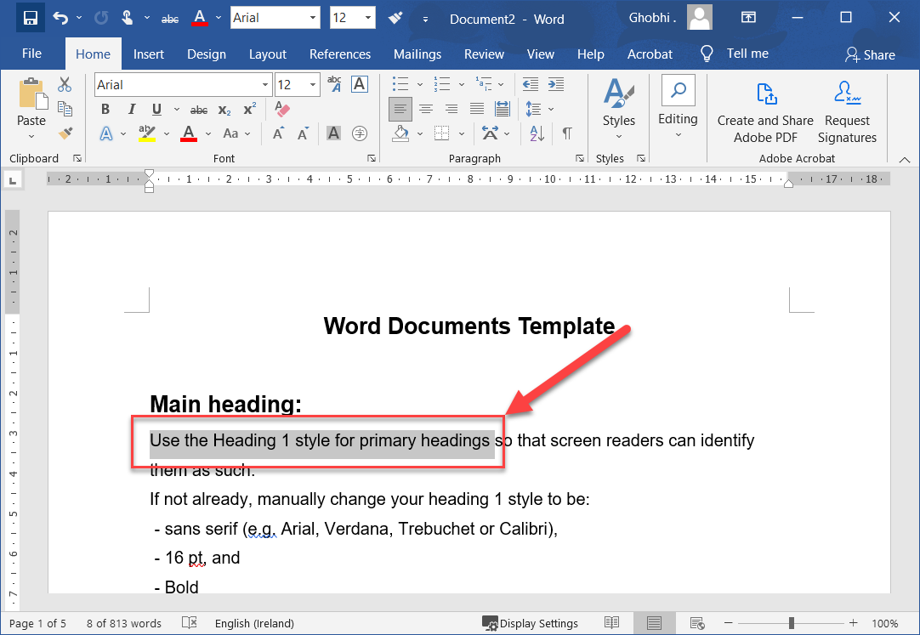
Select & Edit Text
The greatest advantage of using a word processor is how easy it is to edit text throughout a document. One quick and easy way to edit text is by selecting it and then typing over it to replace it.
使用文字处理器的最大优势是可以轻松地在整个文档中编辑文本。编辑文本的一种快速简便的方法是选择它，然后在上面键入以替换它。

Slide 6
Select & Edit Text
Selecting text is a very important skill in Word. Whenever you want to edit or format text, you first need to select it. There are multiple ways to select text, letting you select a small amount to entire paragraphs at once. 在 Word 中选择文本是一项非常重要的技能。每当您想要编辑或格式化文本时，您首先需要选择它。有多种选择文本的方法，让您可以一次选择少量到整个段落。

Slide 7
Select & Edit Text
Click and drag across the text you want to select. You can select any amount of text with this method, from a single character to your entire document.
单击并拖动要选择的文本。您可以使用此方法选择任意数量的文本，从单个字符到整个文档。

Slide 8
Select & Edit Text
Here are some other ways to select text you’ll find useful:
以下是一些其他有用的选择文本的方法：
Press and hold down the Shift key, and move the insertion point either with your mouse or the arrow keys to select text.
按住 Shift 键，然后使用鼠标或箭头键移动插入点以选择文本。

Slide 9
Select & Edit Text
Here are some other ways to select text you’ll find useful:
这里有一些其他的方法来选择你会觉得有用的文本
Double-click a single word to select it.
双击单个单词以将其选中。
Triple-click in a paragraph, or double-click in the left margin next to a paragraph, to select it.
在段落中单击三次，或在段落旁边的左边距中双击以选择它。

Slide 10
Select & Edit Text
Here are some other ways to select text you’ll find useful:
这里有一些其他的方法来选择你会觉得有用的文本
Click in the left margin to select an entire line, or click and drag in the left margin to select multiple lines.
单击左边距可选择整行，或单击并拖动左边距可选择多行。

Slide 11
Select & Edit Text
Here are some other ways to select text you’ll find useful:
这里有一些其他的方法来选择你会觉得有用的文本
Press Ctrl + A to select everything in the document.
按 Ctrl + A 选择文档中的所有内容。

Slide 12
Edit Text
Select the text you want to replace, then start typing the new text.
选择要替换的文本，然后开始键入新文本。

Slide 13
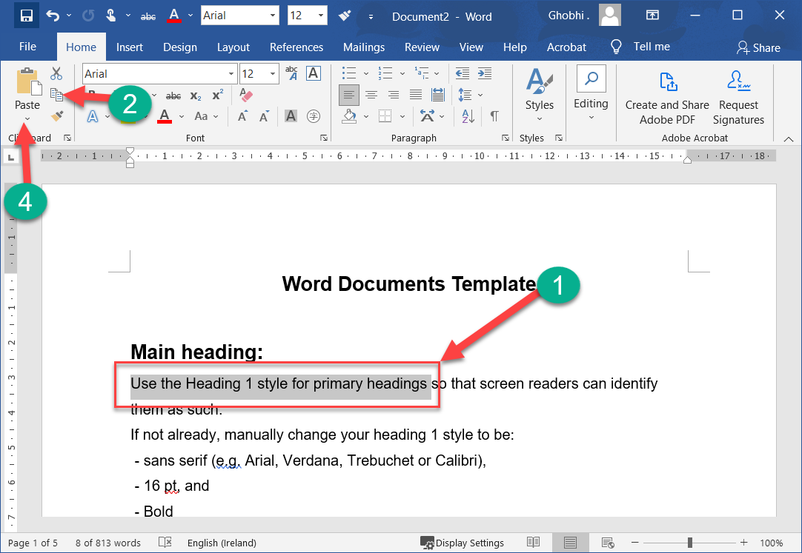
Cut, Copy & Paste
You can move or copy text in a Word document by cutting or copying a selection and then pasting the text in a new location.
您可以通过剪切或复制所选内容，然后将文本粘贴到新位置来移动或复制 Word 文档中的文本。

Slide 14
Cut, Copy & Paste
You can cut, copy, and paste any item—like pictures, shapes, or tables—not just text.
您可以剪切、复制和粘贴任何项目（例如图片、形状或表格），而不仅仅是文本。

Slide 15
Cut, Copy & Paste
Cutting or copying an item places it in a special area called the Clipboard, which stores data temporarily until it can be placed somewhere else.
剪切或复制项目会将其放置在称为剪贴板的特殊区域中，该区域会临时存储数据，直到可以将其放置在其他地方。

Slide 16
Copy & Paste
Copying text lets you duplicate the selected text so it can be used somewhere else.
复制文本可让您复制选定的文本，以便在其他地方使用。
Select the text you want to copy. | 选择要复制的文本。

Slide 17
Copy & Paste
Click the Copy button on the Home tab. | 单击主页选项卡上的复制按钮。
A copy of the selected text is placed in the Clipboard.
所选文本的副本放置在剪贴板中。
Shortcut: Press Ctrl + C to copy.
快捷方式：按 Ctrl + C 进行复制。

Slide 18
Copy & Paste
Click where you want to paste the text. | 单击要粘贴文本的位置。
You can copy, cut, and paste text or other items within a document, between documents, or between programs.
您可以在文档内、文档之间或程序之间复制、剪切和粘贴文本或其他项目。

Slide 19
Copy & Paste
Click the Paste button. | 单击粘贴按钮。
Shortcut: Press Ctrl + V to paste.
快捷方式：按 Ctrl + V 进行粘贴。
The text you copied is duplicated in the new location.
您复制的文本将复制到新位置。

Slide 20
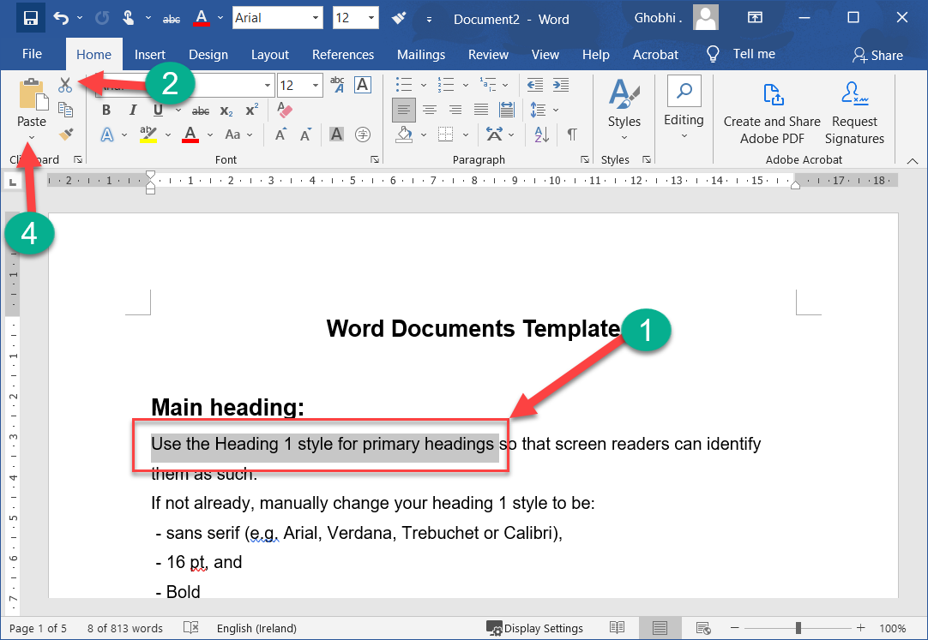
Cut & Paste
When you cut text, it is removed from its original location and placed in the Clipboard.
剪切文本时，它会从其原始位置移除并放置在剪贴板中

Slide 21
Cut & Paste
Select the text you want to cut. | 选择要剪切的文本。
Click the Cut button. | 单击剪切按钮。
Shortcut: Press Ctrl + X.
快捷方式：按 Ctrl + X。

Slide 22
Cut & Paste
Click where you want to paste the text. | 单击要粘贴文本的位置。
Click the Paste button. | 单击粘贴按钮。

Slide 23
Cut & Paste
Shortcut: Select the text you want to move, then click and drag the selected text to where you want to place it. (Pressing Ctrl while moving will copy it.)
快捷方式：选择要移动的文本，然后单击选定的文本并将其拖动到要放置的位置。 （移动时按 Ctrl 将复制它。）

Slide 24
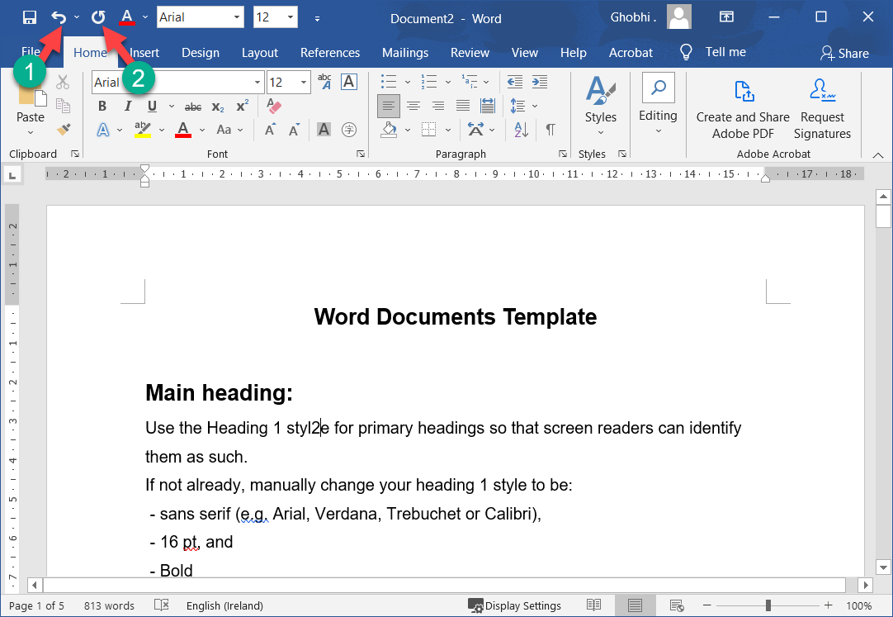
Undo, Redo & Repeat
You don’t need to be afraid of making a mistake in Word, because you can use the Undo feature to erase your actions.
您不必害怕在 Word 中犯错，因为您可以使用撤消功能来删除您的操作。

Slide 25
Undo, Redo & Repeat
The undo, redo, and repeat commands are very useful for working with text in a document.
撤消、重做和重复命令对于处理文档中的文本非常有用.

Slide 26
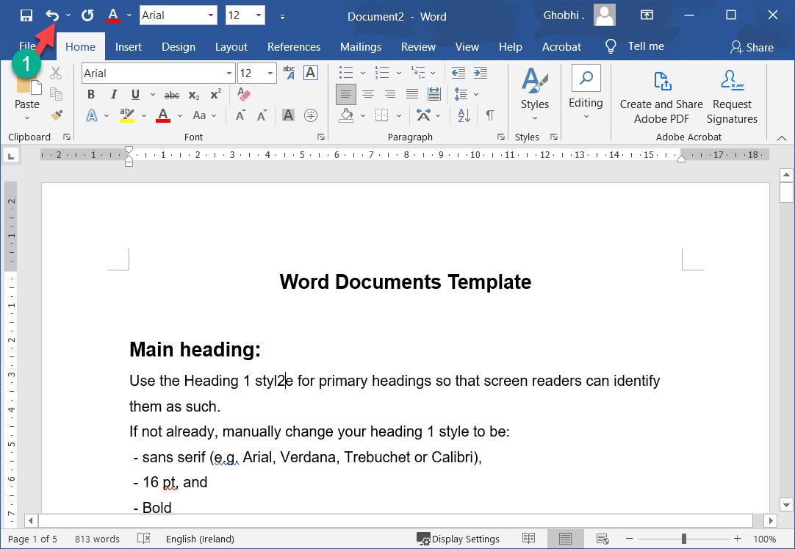
Undo a Single Change
Click the Undo button.
单击撤消按钮。
Shortcut: Press Ctrl + Z.
快捷方式：按 Ctrl + Z。

Slide 27
Undo a Single Change
Your last action is undone. For example, if you had deleted an item and then decided you wanted to keep it after all, undo would make it reappear.
您的上一个操作已撤消。例如，如果您删除了一个项目，然后又决定要保留它，则撤消会使其重新出现。

Slide 28
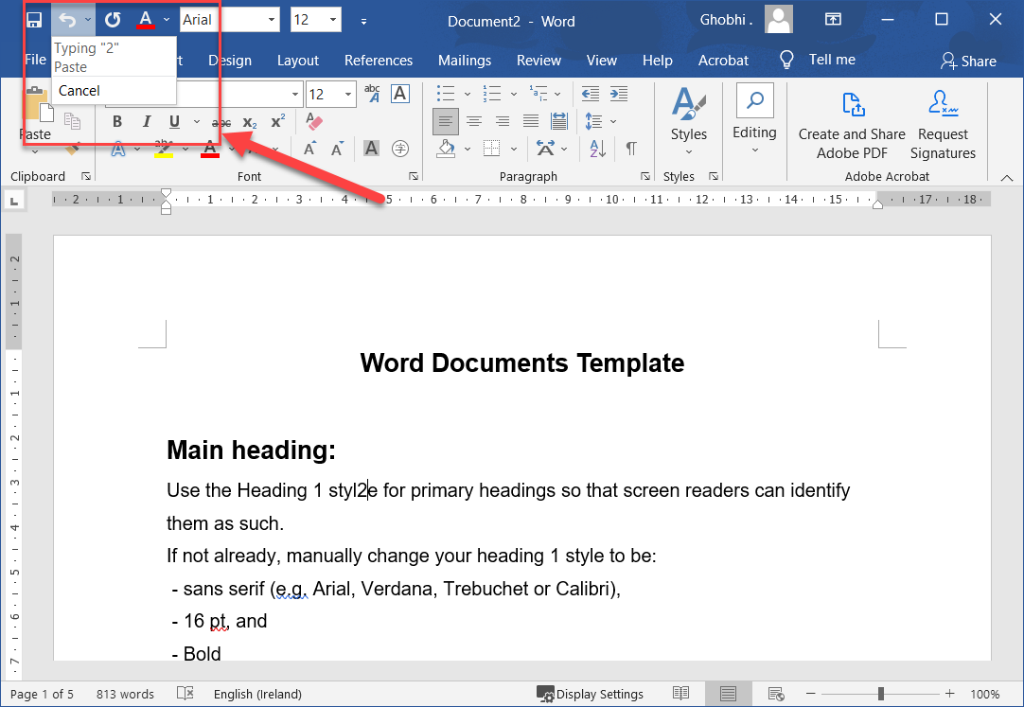
Undo Multiple Changes
Click the Undo list arrow.
单击撤消列表箭头。
A list of recently-performed actions appears.
将显示最近执行的操作列表。

Slide 29
Undo Multiple Changes
To undo multiple actions, select the oldest command you want to undo.
要撤消多个操作，请选择要撤消的最旧的命令。
For example, to undo the last two actions, select the second action in the list.
例如，要撤消最后两个操作，请选择列表中的第二个操作。

Slide 30
Undo Multiple Changes
Select a change to undo everything since that point.
选择更改以撤消自那时以来的所有内容。
The command you select and all subsequent actions are undone.
您选择的命令和所有后续操作都将撤消。

Slide 31
Undo Multiple Changes
You can undo a nearly-unlimited number of actions in Word, even after saving the document. The undo history is cleared when the document is closed.
即使在保存文档之后，您也可以在 Word 中撤消几乎无限数量的操作。当文档关闭时，撤消历史被清除。

Slide 32
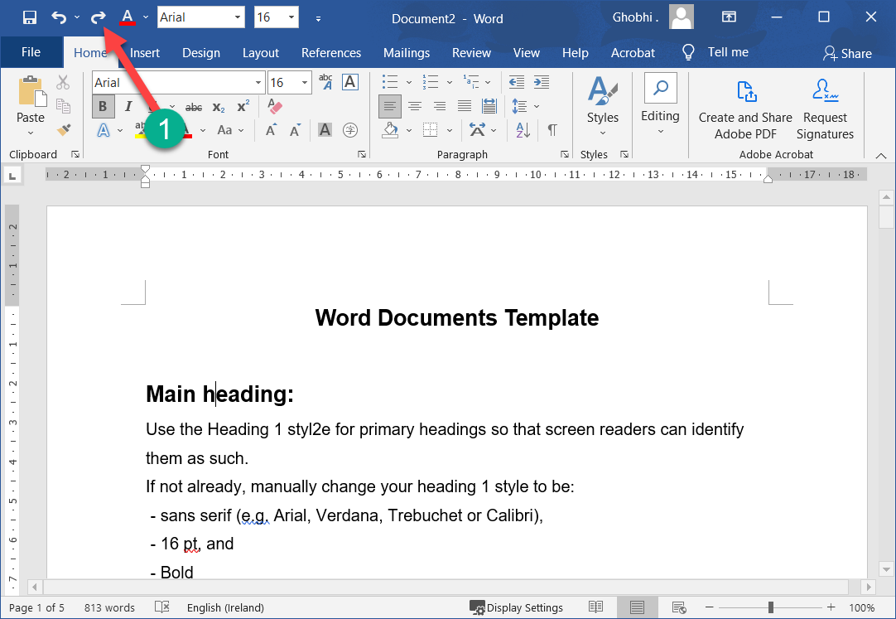
Redo
Redo is the opposite of undo: it redoes an action you have undone.
重做与撤消相反：它重做您已撤消的操作。

Slide 33
Redo
For example, if you decide that you do, after all, want to delete an item that you have just brought back with undo, you can redo the action.
例如，如果您决定要删除刚刚通过撤消恢复的项目，则可以重做该操作。

Slide 34
Redo
Redo button is only available right after you’ve undone something.
重做按钮仅在您撤消某些操作后才可用。
When Redo isn’t available, the button is replaced by the Repeat button.
当重做不可用时，该按钮被重复按钮取代

Slide 35
Redo
Click the Redo button.
单击重做按钮。
Shortcut: Press Ctrl + Y. The last action you undid is redone.
快捷方式：按 Ctrl + Y。您撤消的最后一个操作是重做。
Click the Redo button multiple times to redo multiple actions.
多次单击重做按钮以重做多个操作。

Slide 36
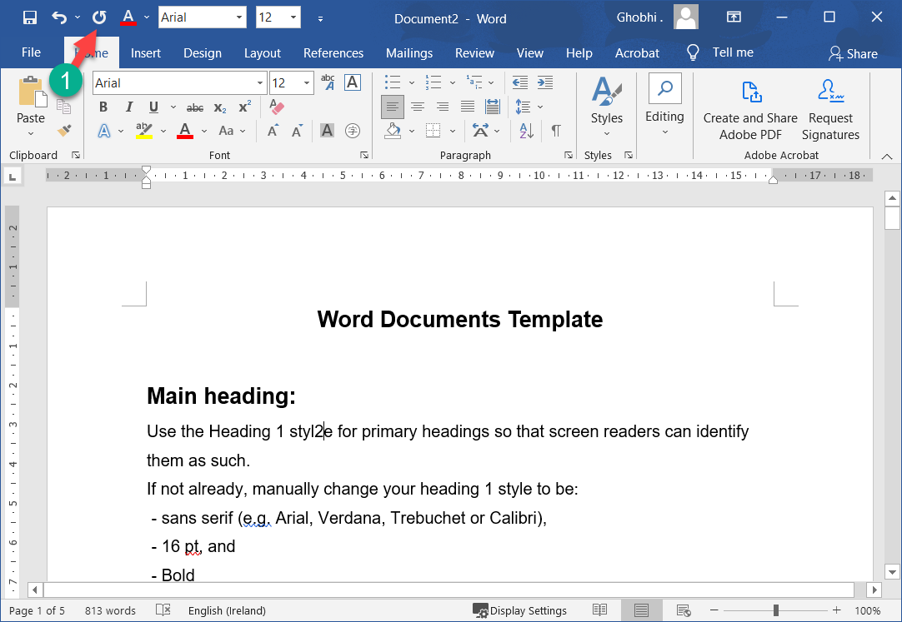
Repeat
Repeat is different from redo; repeat applies the last command to any selected text.
重复不同于重做；重复将最后一个命令应用于任何选定的文本。

Slide 37
Repeat
For example, rather than applying bold formatting to multiple instances of text by clicking the Bold button repeatedly, you can repeat the bold command with the Repeat button or keystroke.
例如，不是通过重复单击粗体按钮将粗体格式应用于多个文本实例，而是可以使用重复按钮或击键重复粗体命令

Slide 38
Repeat
Click the Repeat button.
单击重复按钮。
Shortcut: Press Ctrl + Y.
快捷方式：按 Ctrl + Y。

Slide 39
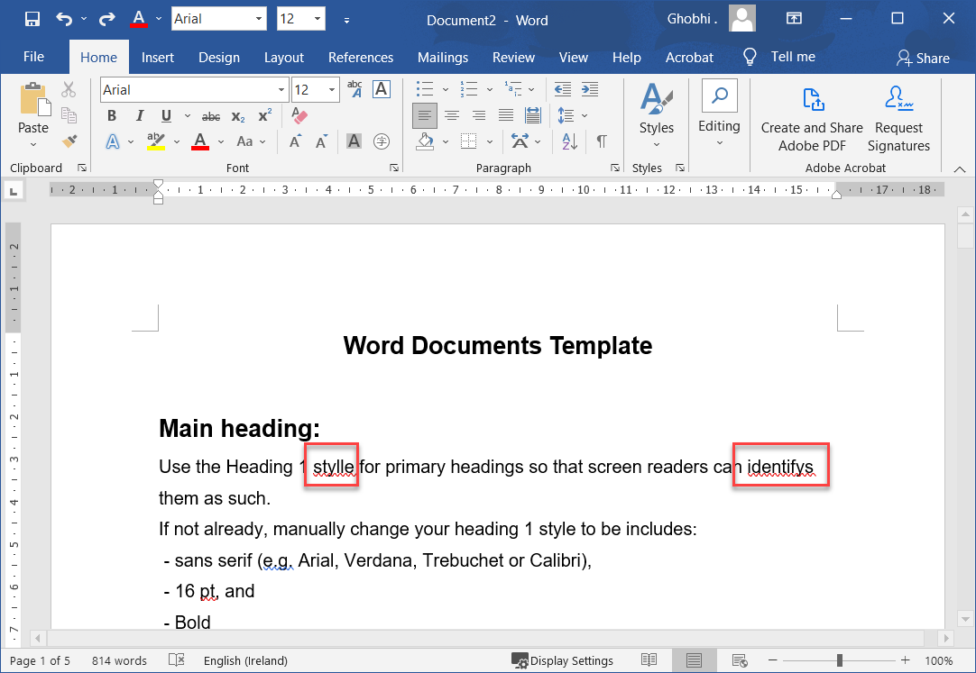
Check Spelling & Grammar
Part of editing your documents is making sure that everything is spelled and assembled correctly.
编辑文档的一部分是确保所有内容都正确拼写和组装。

Slide 40
Check Spelling & Grammar
Word is a great help in this regard because it can identify spelling and grammar errors in your documents.
Word 在这方面很有帮助，因为它可以识别文档中的拼写和语法错误

Slide 41
Check Spelling & Grammar
As you type, Word will automatically check your spelling and grammar.
在您键入时，Word 会自动检查您的拼写和语法。

Slide 42
Check Spelling & Grammar
Word’s AutoCorrect feature will fix small errors and common misspellings, while less-common problems will be highlighted with a colored underline.
Word 的自动更正功能将修复小错误和常见的拼写错误，而不太常见的问题将用彩色下划线突出显示

Slide 43
Check Spelling & Grammar
Potential spelling errors are given a wavy underline in red.
潜在的拼写错误用红色波浪下划线标出。
Potential grammar errors are given a double-underline in blue
潜在的语法错误用蓝色双下划线标出

Slide 44
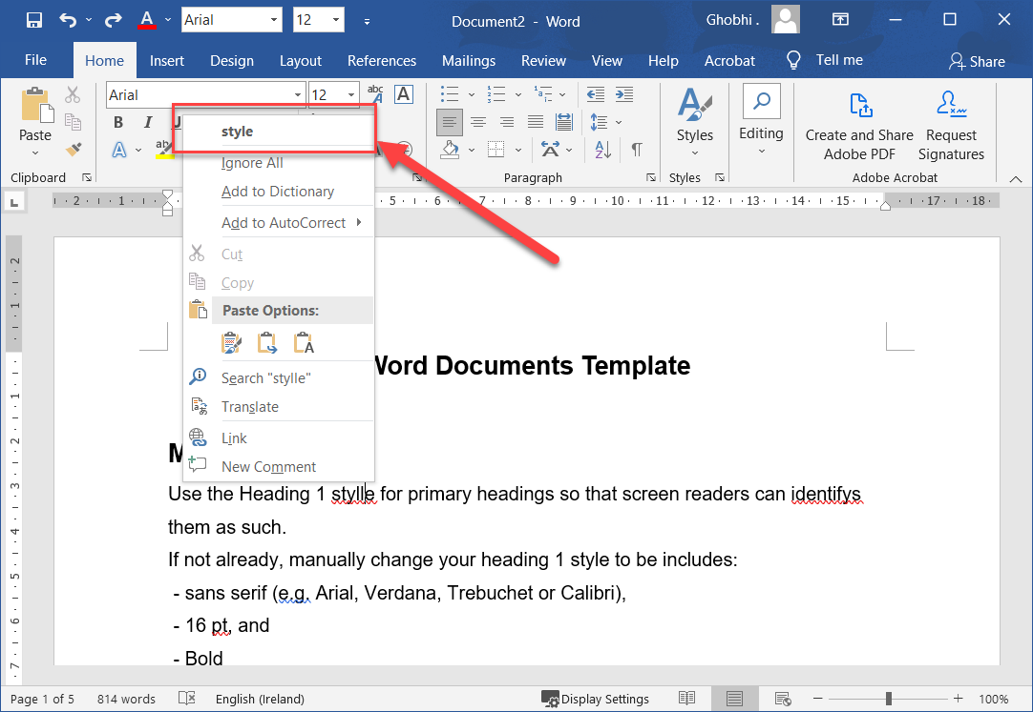
Correct a Spelling & Grammar Error
Once a spelling or grammar error has been highlighted, you could always correct it manually by deleting and retyping it, or you can see some suggested corrections.
突出显示拼写或语法错误后，您始终可以通过删除和重新键入来手动更正它，或者您可以看到一些建议的更正

Slide 45
Correct a Spelling & Grammar Error
Right-click the error. The Spelling (or Grammar) contextual menu appears, showing some suggestions for the misspelled word (or grammatical error), along with definitions for the suggested words.
右键单击错误。出现拼写（或语法）上下文菜单，显示拼写错误（或语法错误）的一些建议，以及建议词的定义。

Slide 46
Correct a Spelling & Grammar Error
Select the suggestion you want to use, if it appears.
选择您要使用的建议（如果出现）。
The misspelled word (or grammatical error) is automatically updated.
拼写错误的单词（或语法错误）会自动更新。

Slide 47
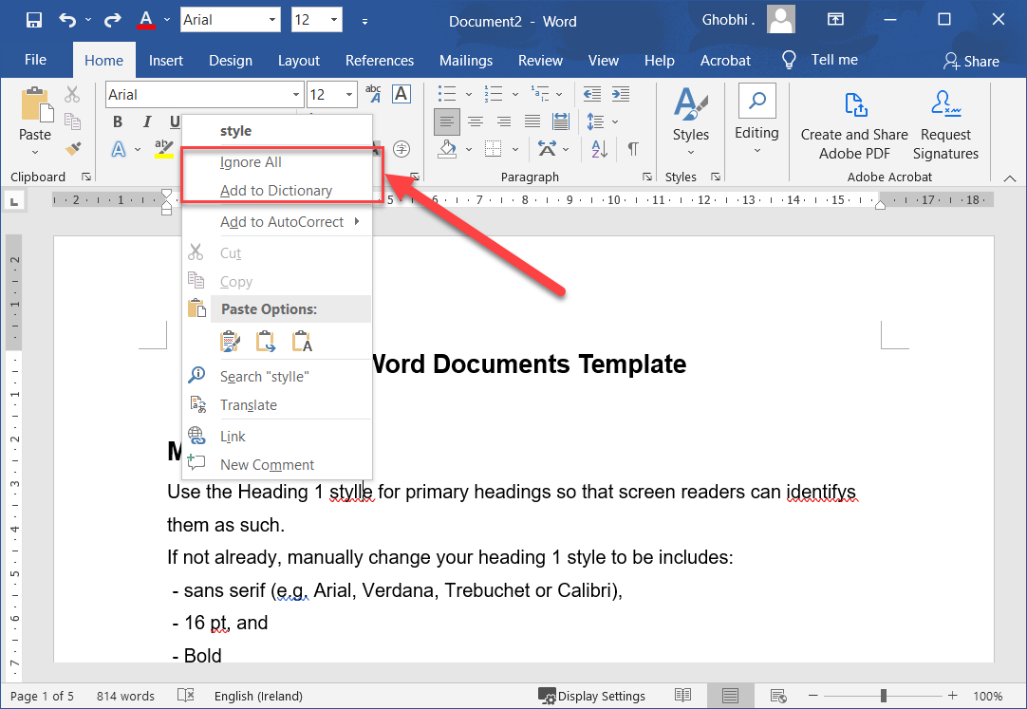
Ignore a Spelling & Grammar Error
Not all misspellings and grammar mistakes that Word identifies will be actual mistakes.
并非 Word 识别的所有拼写错误和语法错误都是实际错误。

Slide 48
Ignore a Spelling & Grammar Error
For example, names will often be marked as misspelled words, even when they’re properly spelled.
例如，名称通常会被标记为拼写错误的单词，即使拼写正确也是如此。

Slide 49
Ignore a Spelling & Grammar Error
Right-click the error.
右键单击错误。
Depending on whether it’s a spelling error or grammatical error, you’ll be able to ignore all instances of the misspelled word, or this single instance of a grammatical error.
根据是拼写错误还是语法错误，您将能够忽略拼写错误的单词的所有实例，或语法错误的单个实例。

Slide 50
Ignore a Spelling & Grammar Error
Select Ignore All (for misspelled words) or Ignore Once (for grammatical errors).
选择全部忽略（对于拼写错误的单词）或忽略一次（对于语法错误）。
The selected word (or grammatical error) is ignored.
所选单词（或语法错误）将被忽略。

Slide 51
Add a Word to the Dictionary
If a word gets marked as misspelled, but it’s a correctly spelled word that just isn’t in Word’s dictionary— such as a person’s name or a company name—you can add it to the dictionary so that it doesn’t get marked as misspelled in the future.
如果某个单词被标记为拼写错误，但它是 Word 字典中没有的拼写正确的单词（例如人名或公司名称），您可以将其添加到字典中，以免被标记为拼写错误在将来

Slide 52
Add a Word to the Dictionary
Right-click the error. Select Add to Dictionary. The word is added to the dictionary.
右键单击错误。选择添加到词典。这个词被添加到字典中。

Slide 53
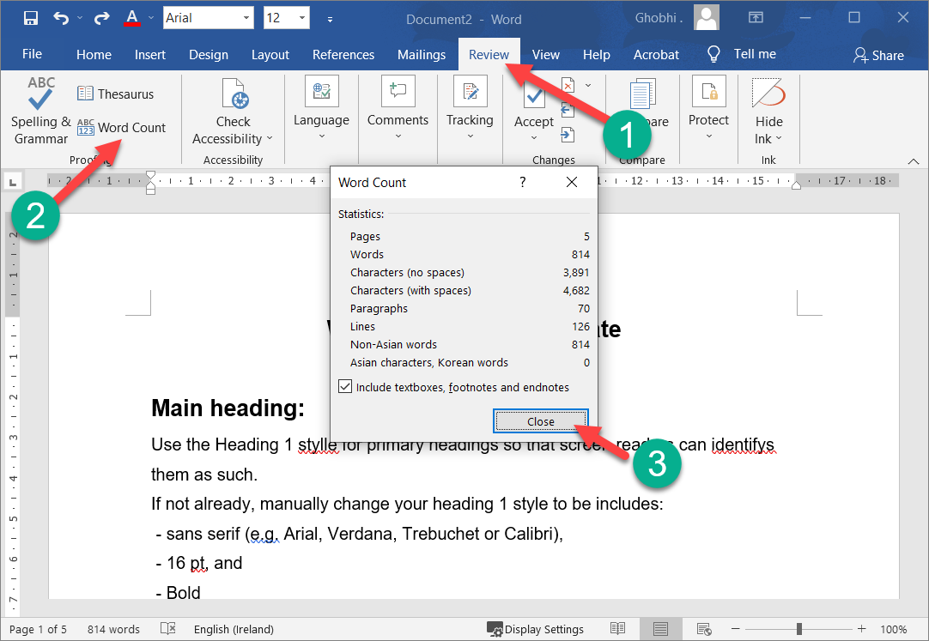
Word Count
The Word Count feature is useful if you have a writing assignment that is limited to a specific number of words.
如果您的写作作业仅限于特定字数，则字数统计功能非常有用。

Slide 54
Word Count
The word count is always displayed in the status bar at the bottom of the screen, next to the page number. If you need to see a more detailed count of words, open the Word Count dialog box.
字数始终显示在屏幕底部的状态栏中，页码旁边。如果您需要查看更详细的字数统计，请打开字数统计对话框

Slide 55
Word Count
Click the Review tab on the ribbon. | 单击功能区上的“审阅”选项卡。

Slide 56
Word Count
Click the Word Count button in the proofing group. | 单击校对组中的字数统计按钮。
Shortcut: You can also click the word count in the status bar to open the Word Count dialog box.
快捷方式：您也可以单击状态栏中的字数统计，打开字数统计对话框。

Slide 57
Word Count
Here you can see not only the word count, but also a character count (both with and without spaces), a paragraph count, and a line count.
在这里，您不仅可以看到字数统计，还可以看到字符数（有空格和没有空格）、段落数和行数。

Slide 58
Word Count
Click Close when you’re done. | 完成后单击关闭。
The Word Count dialog box closes.
字数统计对话框关闭。

Slide 59
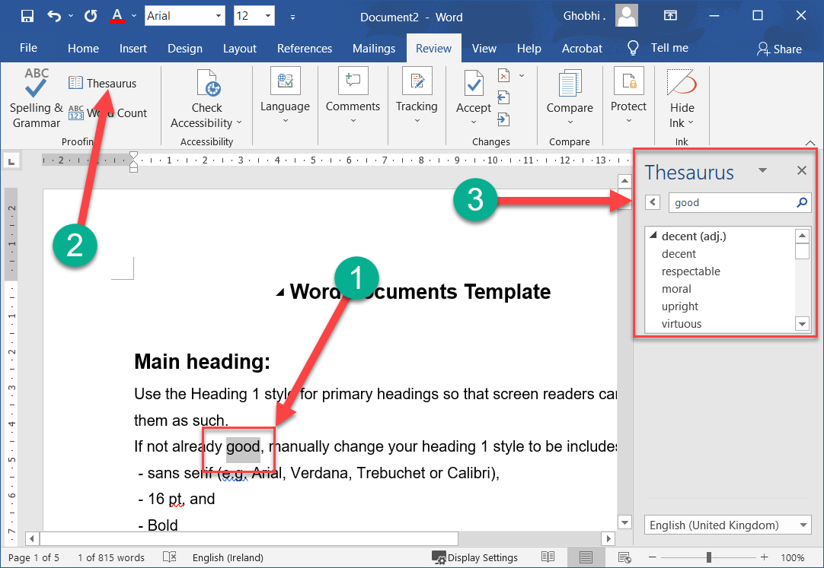
Thesaurus
Use Word’s built-in thesaurus to help you find synonyms of a word.
使用 Word 的内置同义词帮助您查找单词的同义词。

Slide 60
Thesaurus
For example, you can use the thesaurus to replace the ho-hum word “good” with one of its synonyms, such as “decent,” “respectable,” or “upright.
例如，您可以使用同义词库将乏味的单词“good”替换为其同义词之一，例如”decent”, “respectable”或 ”upright”。

Slide 61
Thesaurus
Select the word you want to replace. | 选择要替换的单词。

Slide 62
Thesaurus
On the Review tab, click Thesaurus. | 在审阅选项卡上，单击同义词库。

Slide 63
Thesaurus
The Thesaurus pane at the right shows a list of words with similar meanings to your selection. If a word has multiple meanings, each meaning will have its own list of synonyms.
右侧的叙词窗格显示与您的选择具有相似含义的单词列表。如果一个词有多种含义，则每个含义都有自己的同义词列表。

Slide 64
Thesaurus
Hover over a new word and click the menu arrow. | 将鼠标悬停在一个新词上，然后单击菜单箭头。
Click the Insert button. | 单击插入按钮。
Your selection is replaced with the new word.
您的选择将替换为新单词。

Slide 65
Thesaurus
Close the Thesaurus pane when you’re done. | 完成后关闭同义词库窗格。
Shortcut: Right-click a word. Select Synonyms and then select a new word from the list.
快捷方式：右键单击一个单词。选择同义词，然后从列表中选择一个新词。

Slide 66
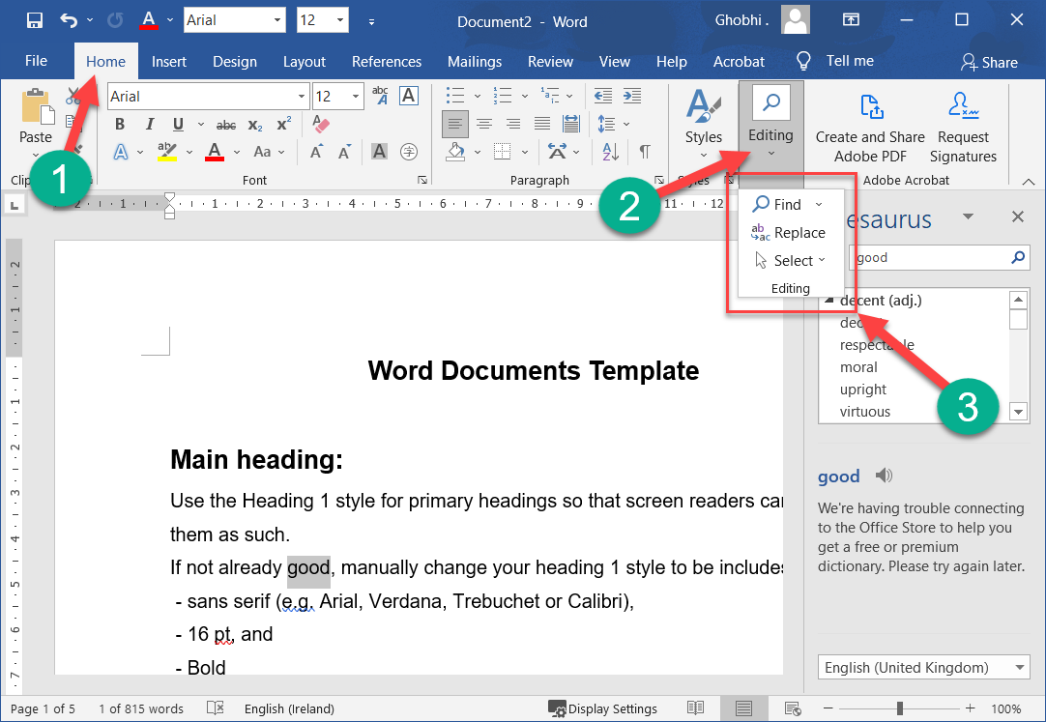
Find & Replace Text
Don’t waste time scanning through your document to find text and replace it with something new.
不要浪费时间扫描文档以查找文本并将其替换为新内容。
The find and replace commands can do this for you with just a few clicks of your mouse.
只需点击几下鼠标，查找和替换命令即可为您完成此操作

Slide 67
Find Text
You can use the Navigation pane to search for specific words or phrases in a document.
您可以使用导航窗格来搜索文档中的特定单词或短语。

Slide 68
Find Text
Click Find on the Home tab. | 单击主页选项卡上的查找。
The Navigation pane appears on the left, displaying the Results view.
导航窗格出现在左侧，显示结果视图。
Shortcut: Press Ctrl + F.
快捷方式：按 Ctrl + F。

Slide 69
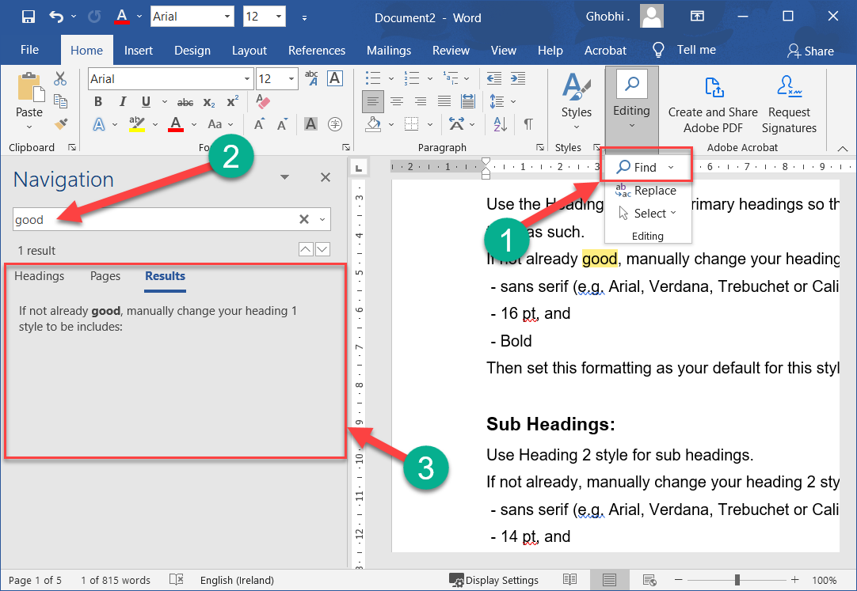
Find Text
Click in the Search document box in the Navigation pane and type the text you want to find. | 单击导航窗格中的搜索文档框，然后键入要查找的文本。

Slide 70
Find Text
The search runs automatically. Results are highlighted in the document, and the Navigation pane lists all instances of the word.
搜索会自动运行。结果在文档中突出显示，导航窗格列出了该词的所有实例。

Slide 71
Find Text
Click a search result to jump to it in the document. | 单击搜索结果可在文档中跳转到该结果。
You can use the arrows under the search box to jump to the Previous or Next search result.
您可以使用搜索框下方的箭头跳转到上一个或下一个搜索结果。

Slide 72
Find Text
Click Close when you're finished. | 完成后单击关闭。
The Navigation pane closes.
导航窗格关闭。

Slide 73
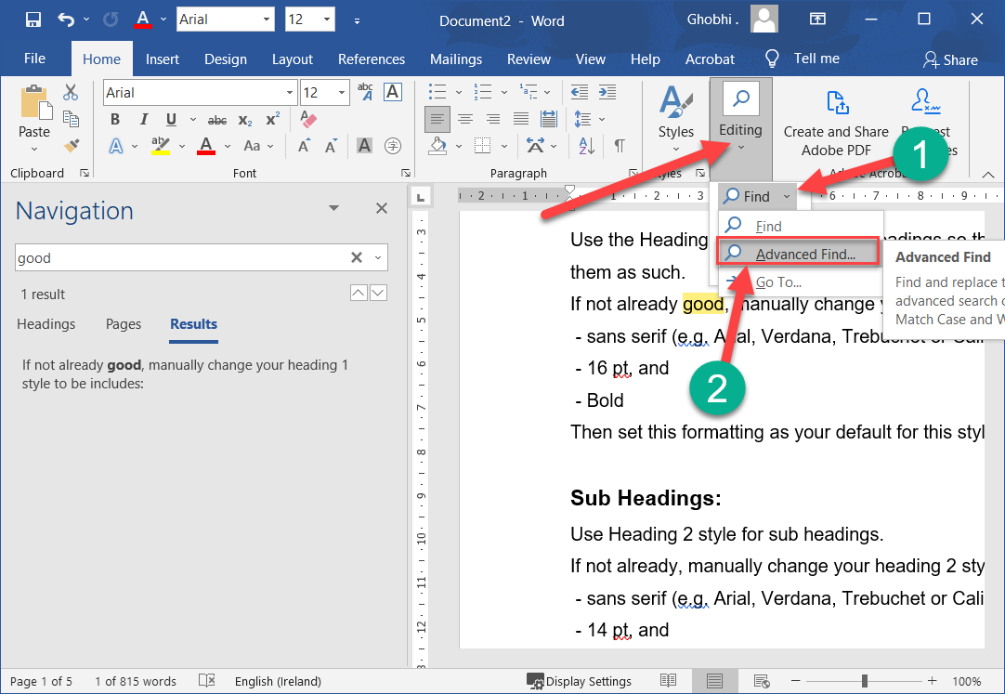
Advanced Find
To search your documents for more specific items, such as certain capitalization or only whole words, use Advanced Find.
要在文档中搜索更具体的项目（例如某些大写或仅整个单词），请使用高级查找

Slide 74
Advanced Find
Click the Find button list arrow. | 单击查找按钮列表箭头。
Select Advanced Find. | 选择高级查找。
The Find and Replace dialog box opens.
“查找和替换”对话框打开。

Slide 75
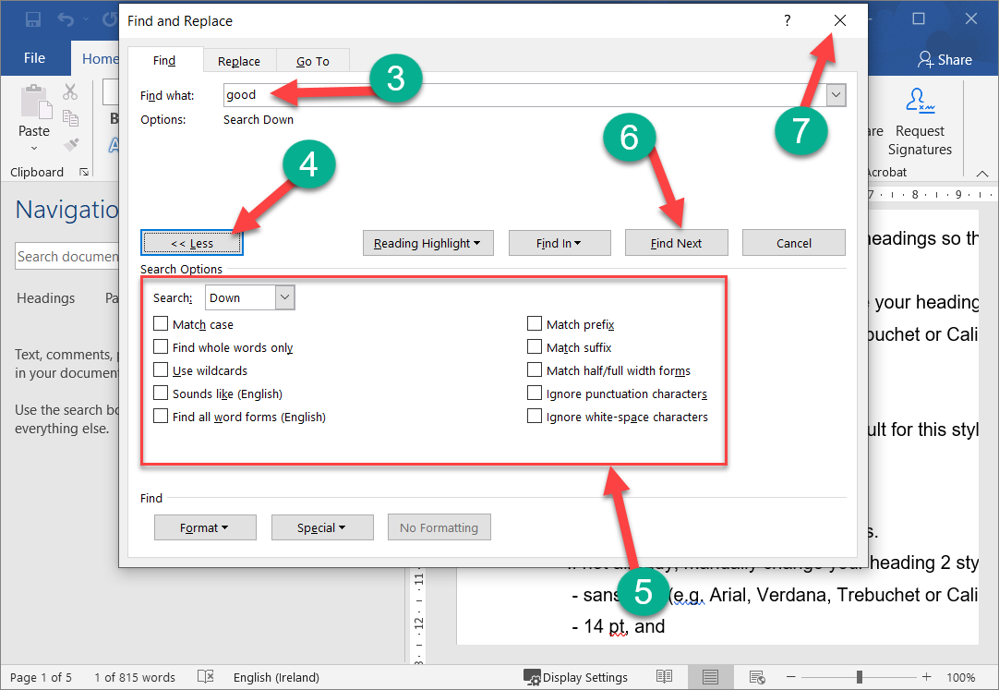
Advanced Find
Type the word you're looking for in the Find box. | 在“查找”框中键入您要查找的单词。

Slide 76
Advanced Find
By default, the Find and Replace dialog box only shows the basics—a search field. There are more options available if you expand the dialog box.
默认情况下，“查找和替换”对话框仅显示基本内容 — 搜索字段。如果您展开对话框，还有更多可用选项。

Slide 77
Advanced Find
Click the More button. | 单击更多按钮。
The advanced options here let you set some options on how to conduct the search.
此处的高级选项可让您设置有关如何进行搜索的一些选项。

Slide 78
Advanced Find
Check the advanced criteria you want to use. | 检查您要使用的高级条件。
You can choose to exactly match the case or only search for whole words. You can also use wildcards, or ignore punctuation and spacing.
您可以选择完全匹配大小写或仅搜索整个单词。您还可以使用通配符，或忽略标点符号和空格。

Slide 79
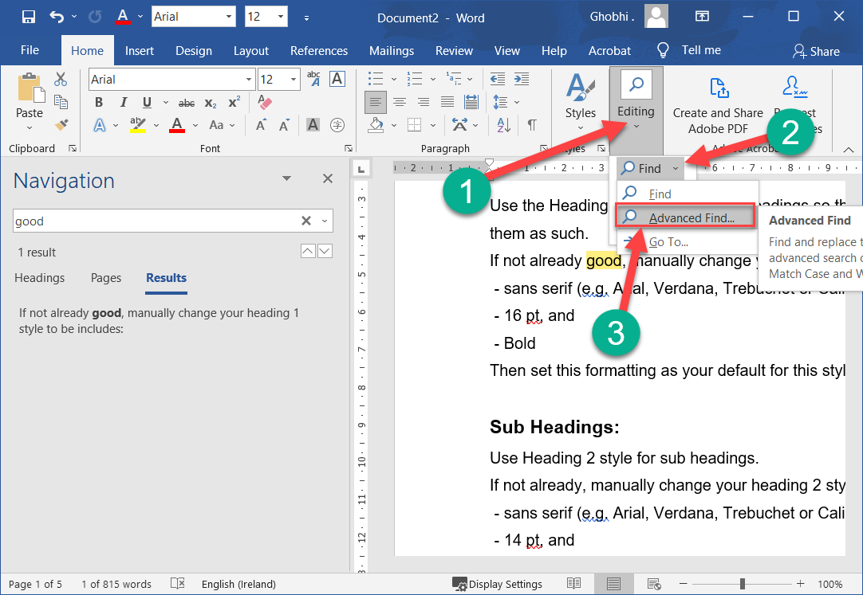
Advanced Find
Click Find Next. |单击查找下一个。
Word navigates to and selects the next instance that fits the additional criteria.
Word 导航到并选择符合附加条件的下一个实例。

Slide 80
Advanced Find
Click Close when you’re done. | 完成后单击关闭。
The Find and Replace dialog box closes.
查找和替换对话框关闭。

Slide 81
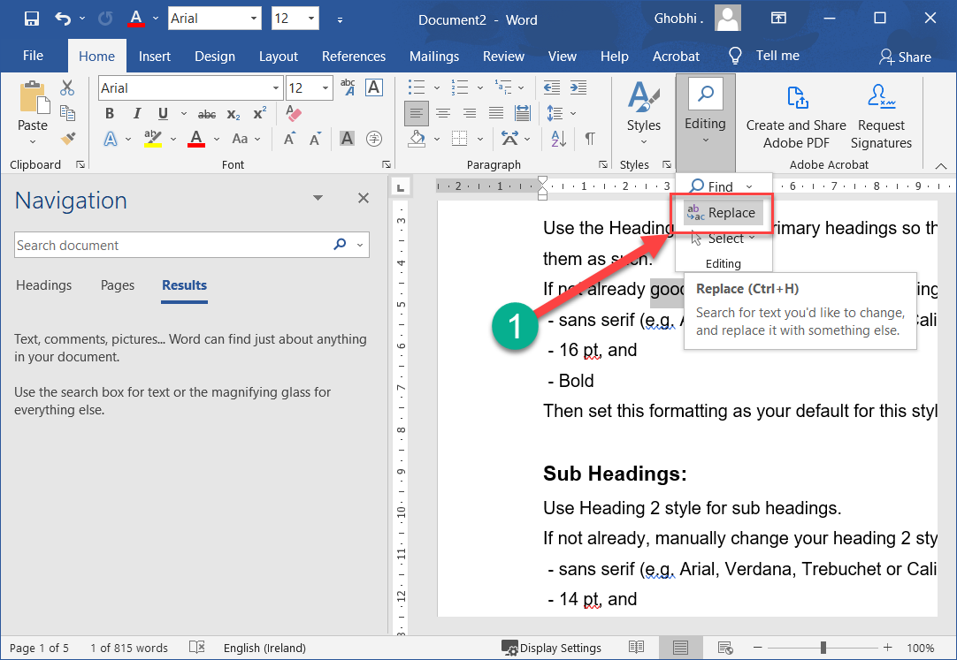
Replace Text
If you’ve spelled something incorrectly in multiple places, Word can fix them all with just a few steps.
如果您在多个地方拼错了某些内容，Word 只需几个步骤即可全部修复。

Slide 82
Replace Text
Click the Replace button on the Home tab. |单击主页选项卡上的替换按钮。
The Find and Replace dialog box opens to the Replace tab.
“查找和替换”对话框打开到“替换”选项卡。

Slide 83
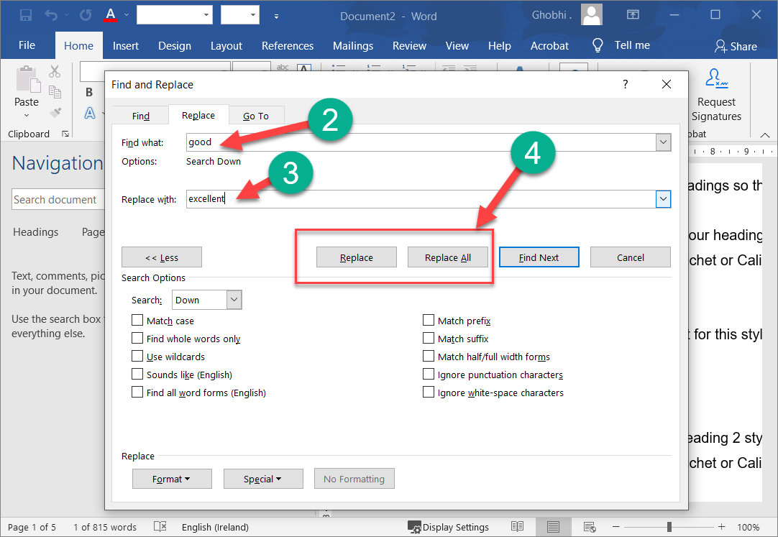
Replace Text
Type the word you need to replace in the Find what text field. | 在查找内容文本字段中键入您需要替换的单词。
Type the corrected word in the Replace with text field. | 在替换为文本字段中键入更正的单词。

Slide 84
Replace Text
Select a replacement option. | 选择替换选项。
Replace: Replaces the first instance of the word. Keep clicking to fix them one at a time.
替换：替换单词的第一个实例。继续单击以一次修复一个。

Slide 85
Replace Text
Select a replacement option. | 选择替换选项。

Slide 86
Replace Text
Replace All: Fixes all instances of the word at once. Once all the instances of the word have been replaced, a dialog box will pop up to let you know it’s complete. Click OK. Click Close when you’re done. The Find and Replace dialog box closes.
全部替换：一次修复单词的所有实例。一旦单词的所有实例都被替换，将弹出一个对话框让您知道它已完成。单击确定。完成后单击关闭。查找和替换对话框关闭。

Slide 87
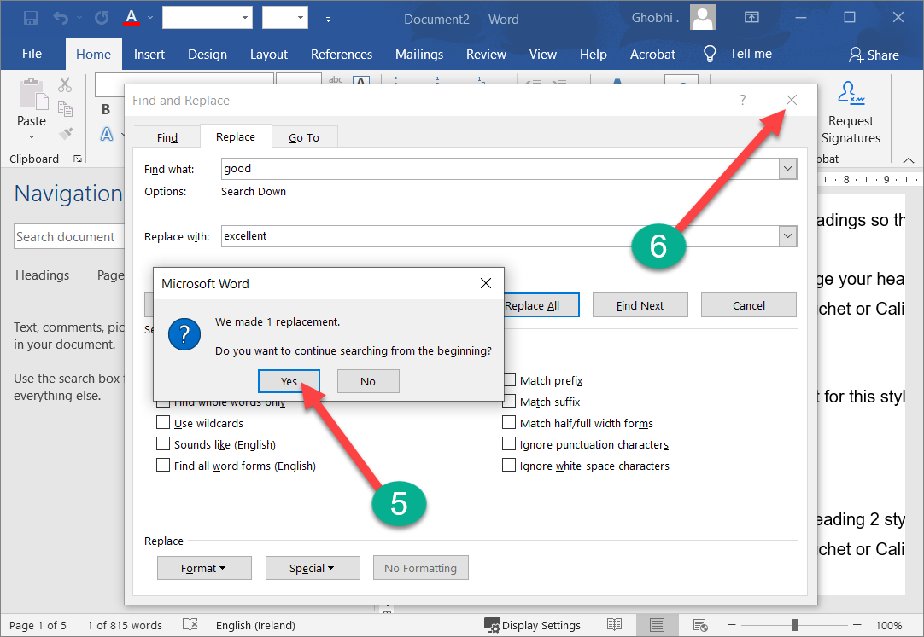
Replace Text
Once all the instances of the word have been replaced, a dialog box will pop up to let you know it’s complete.
一旦单词的所有实例都被替换，将弹出一个对话框让您知道它已完成。

Slide 88
Replace Text
Click Yes & OK. | 单击是并确定。
Click Close when you’re done. | 完成后单击关闭。
The Find and Replace dialog box closes.
查找和替换对话框关闭。

Slide 89
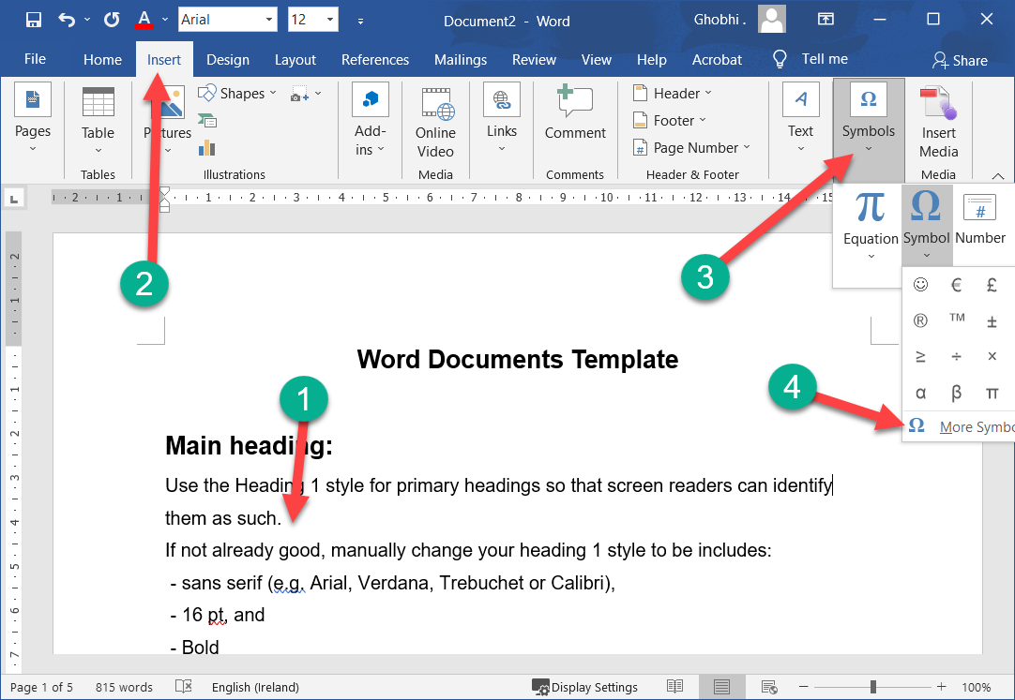
Insert Symbol
Your keyboard doesn’t contain all the characters you might want to include in your documents. Word lets you insert these special symbols and equations separately.
您的键盘未包含您可能希望包含在文档中的所有字符。 Word 允许您分别插入这些特殊符号和方程。

Slide 90
Insert Symbol
Common symbols that you can insert include copyright (©) and trademark (™) symbols, additional punctuation marks (‽), foreign currency symbols (¥), mathematical symbols (÷), and accented characters (ä)
您可以插入的常见符号包括版权 (©) 和商标 (™) 符号、附加标点符号 (‽)、外币符号 (¥)、数学符号 (÷) 和重音字符 (ä)

Slide 91
Insert Symbol
Click where you want to insert the symbol. | 单击要插入符号的位置。
Click the Insert tab. | 单击插入选项卡。

Slide 92
Insert Symbol
Click Symbol. |单击符号
This menu shows recently used symbols. If you need to use a symbol repeatedly, it will be found here after you’ve used it the first time.
此菜单显示最近使用的符号。如果您需要重复使用某个符号，则在您第一次使用它后会在此处找到它。

Slide 93
Insert Symbol
Click More Symbols. | 单击更多符号。

Slide 94
Insert Symbol
The Symbol dialog box opens to the Symbols tab. This lets you browse all the characters contained by the font you’re using. If you’re looking for a common symbol, the Special Characters tab has a shorter list that may have what you need.
“符号”对话框打开到“符号”选项卡。这使您可以浏览您正在使用的字体包含的所有字符。如果您正在寻找通用符号，特殊字符选项卡有一个较短的列表，可能包含您需要的内容。

Slide 95
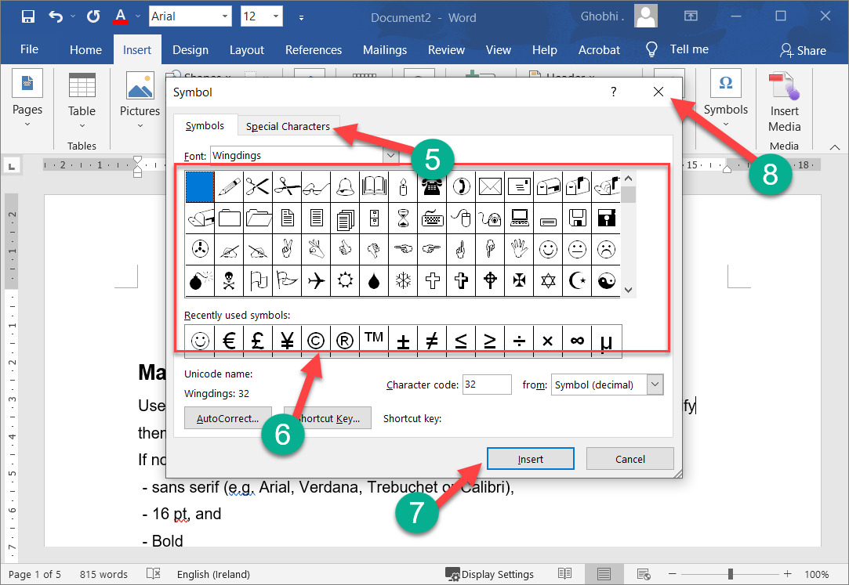
Insert Symbol
If you’re looking for a common symbol, the Special Characters tab has a shorter list that may have what you need.
如果您正在寻找通用符号，特殊字符选项卡有一个较短的列表，可能包含您需要的内容。

Slide 96
Insert Symbol
Click Special Characters. | 单击特殊字符。
This list includes common punctuation characters and the shortcut keys you can use to insert them using your keyboard.
此列表包括常用标点符号和可用于使用键盘插入它们的快捷键。

Slide 97
Insert Symbol
Select a symbol. |选择一个符号。
Click Insert. |单击插入。
The symbol is inserted, even though it may be hard to tell with the dialog box still open.
符号已插入，即使在对话框仍然打开的情况下可能很难分辨。

Slide 98
Insert Symbol
Click Close when you’re done. | 完成后单击关闭。
The Symbol dialog box closes.
符号对话框关闭。

Slide 99
Insert Symbol
Inserting an equation works similarly. Just click the Equation button list arrow on the Insert tab and select an option from the menu.
插入方程的工作原理类似。只需单击“插入”选项卡上的“方程式”按钮列表箭头，然后从菜单中选择一个选项

Slide 100
Thank You!
Social Health Growth
200 Jalan Sultan #03-17, Textile Centre, Singapore 199018
Hotline: (65) 9751 6906, Fax: (65) 6338 2892
SHG is a registered Charity with Ministry of Social and Family Development
Website: www.socialhealthgrowth.org
Facebook: facebook.com/socialhealthgrowth.shg
Twitter: @SHG_Singapore
Instagram: socialhealthgrowth

