Slide 1
Computer & Mobile Literacy Program
Microsoft Word Basic – Part 1: Word Fundamentals

Slide 2
Learning Objectives
To understand what is Microsoft Word
了解什么是 Microsoft Word
To understand Microsoft Word fundamentals
了解 Microsoft Word 基础知识

Slide 3
What is Microsoft Word?
A word processor created by Microsoft for the users to create and format documents.
Microsoft 为用户创建和格式化文档而创建的文字处理器。
You can create and edit text documents right in your computer.
您可以直接在计算机中创建和编辑文本文档。。

Slide 4
What is Microsoft Word?
Microsoft Word is a powerful word processor with a lot of features to help you create professional documents. With so many features, though, it can be pretty daunting at first.
Microsoft Word 是一款功能强大的文字处理器，具有许多可帮助您创建专业文档的功能。但是，有这么多功能，一开始可能会令人生畏。
In today’s class, you will learn the fundamentals of using Microsoft Word.
在今天的课程中，您将学习使用 Microsoft Word 的基础知识。

Slide 5
What is Microsoft Word?
You will get a feel for the interface and learn how to create, open, and save new Word documents.
您将了解界面并了解如何创建、打开和保存新的 Word 文档。
You will also learn how to view and navigate documents, and how to print and share them.
您还将学习如何查看和导航文档，以及如何打印和共享它们

Slide 6
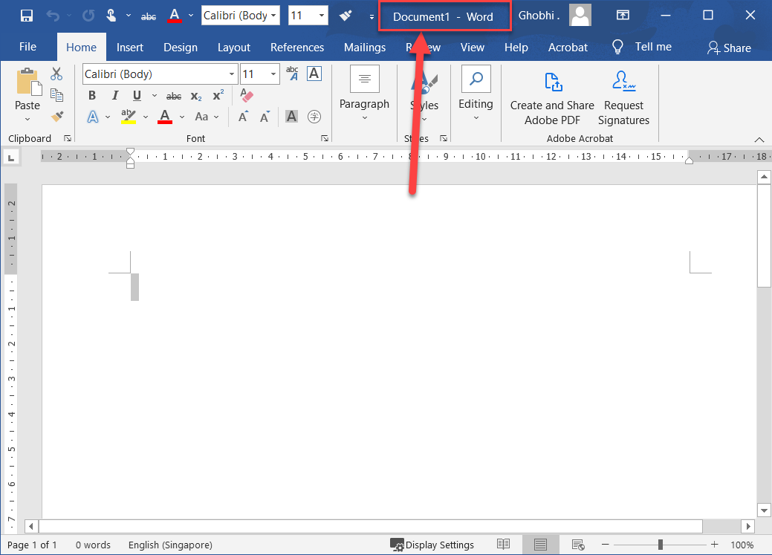
Understand the Screen
Title Bar: Displays the name of the current file.
标题栏：显示当前文件的名称。

Slide 7
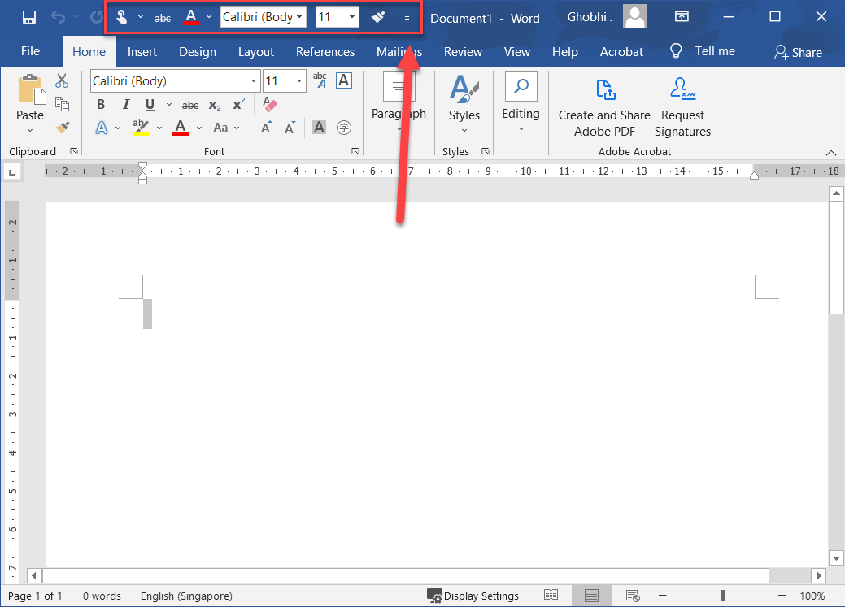
Understand the Screen
Quick Access Toolbar: Contains common commands such as Save and Undo. It can be customized to include many common commands.
快速访问工具栏：包含常用命令，例如保存和撤消。它可以自定义以包含许多常用命令。

Slide 8
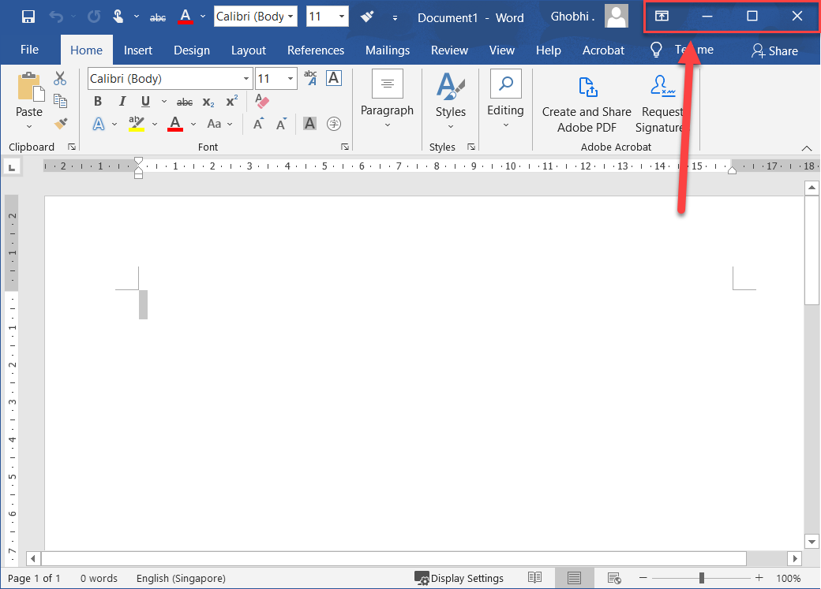
Understand the Screen
Display Options: This is where you can change how much of the ribbon is displayed; minimize, maximize or restore the Word window; or close Word altogether.
显示选项：您可以在此处更改功能区的显示范围；最小化、最大化或恢复 Word 窗口；或完全关闭 Word。

Slide 9
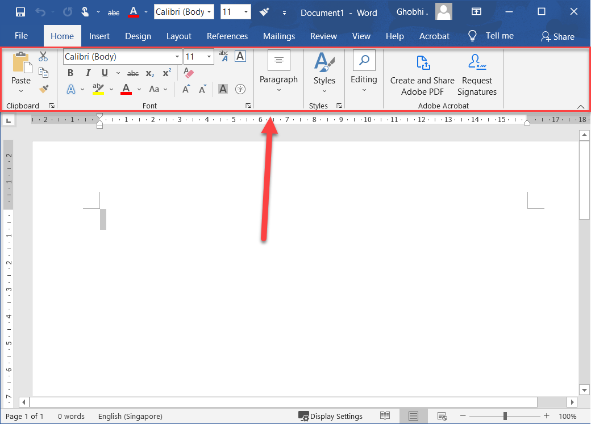
Understand the Screen
Ribbon: This is where you'll find all the options you need to make a stellar document. The options are grouped into tabs.
功能区：在这里您可以找到制作一流文档所需的所有选项。选项被分组到选项卡中

Slide 10
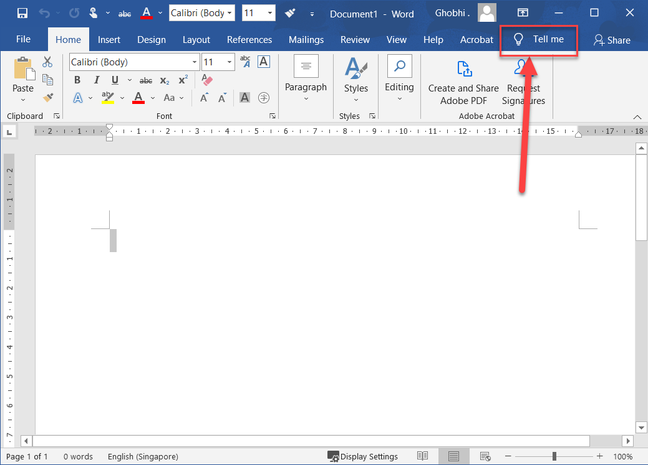
Understand the Screen
Tell Me Search Box: Allows you to search for commands by typing out keywords.
告诉我搜索框：允许您通过键入关键字来搜索命令

Slide 11
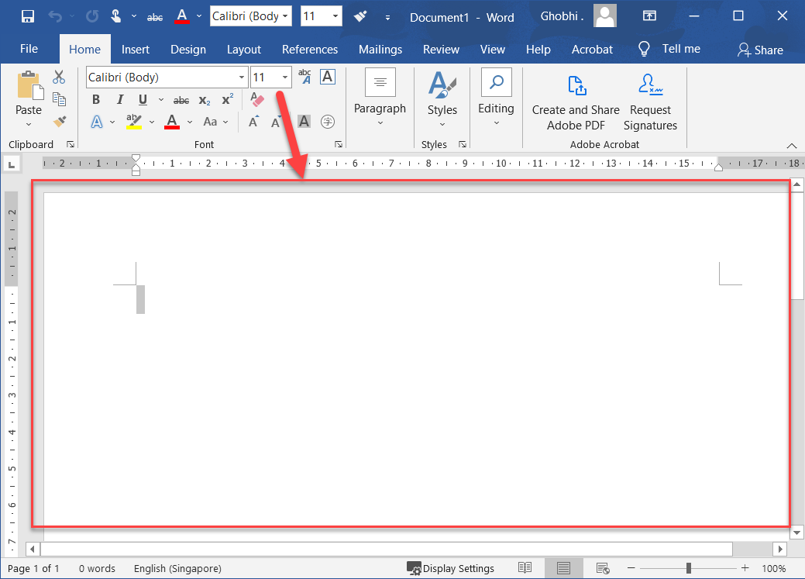
Understand the Screen
Document Window: This is where you see your document, where you edit and format the text.
文档窗口：这是您查看文档、编辑和设置文本格式的地方

Slide 12
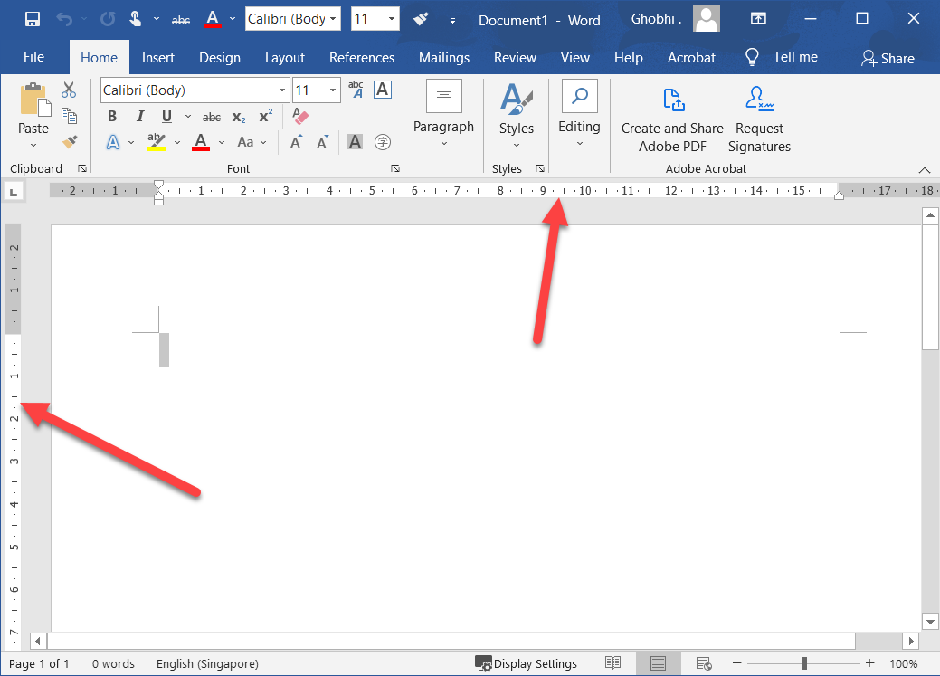
Understand the Screen
Rulers: When the rulers are turned on, they appear at the top and the left of the document.
标尺：当标尺打开时，它们会出现在文档的顶部和左侧。

Slide 13
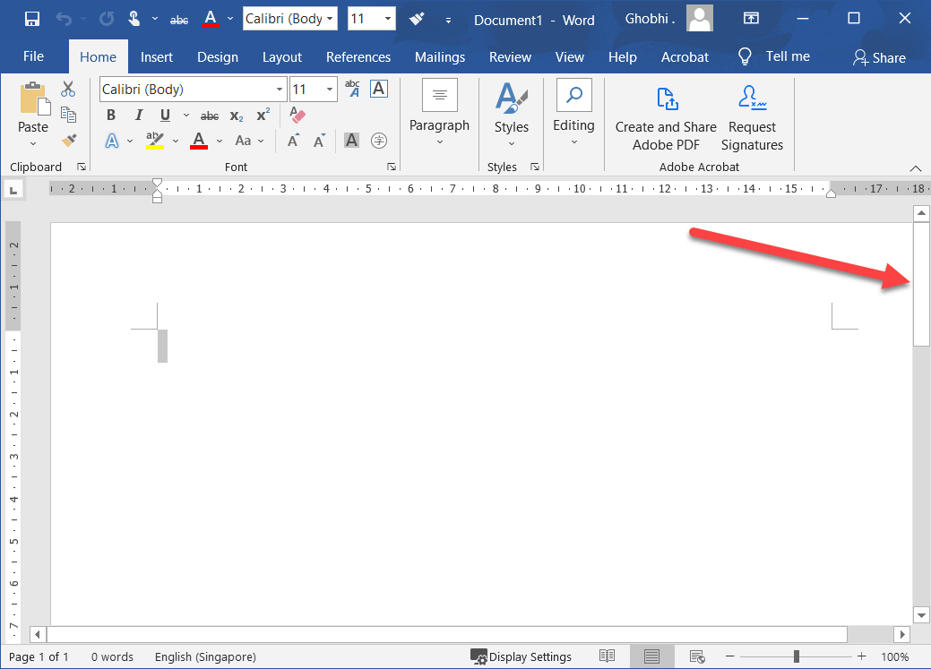
Understand the Screen
Scroll Bars: Use the scroll bars to move up and down or left and right in a document.
滚动条：使用滚动条在文档中上下或左右移动。

Slide 14
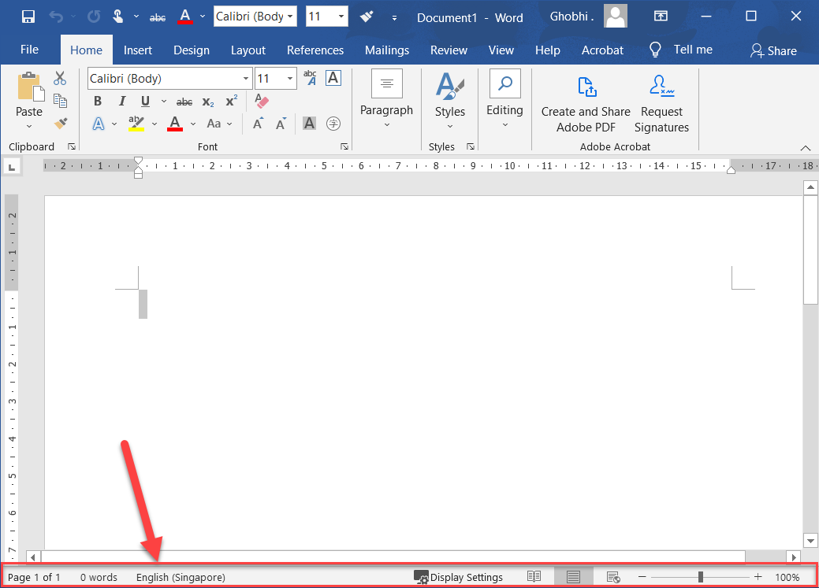
Understand the Screen
Status Bar and Views: Shows summary information like the number of pages and words in the document. Next to it are the buttons to change the document view.
状态栏和视图：显示摘要信息，例如文档中的页数和字数。它旁边是更改文档视图的按钮

Slide 15
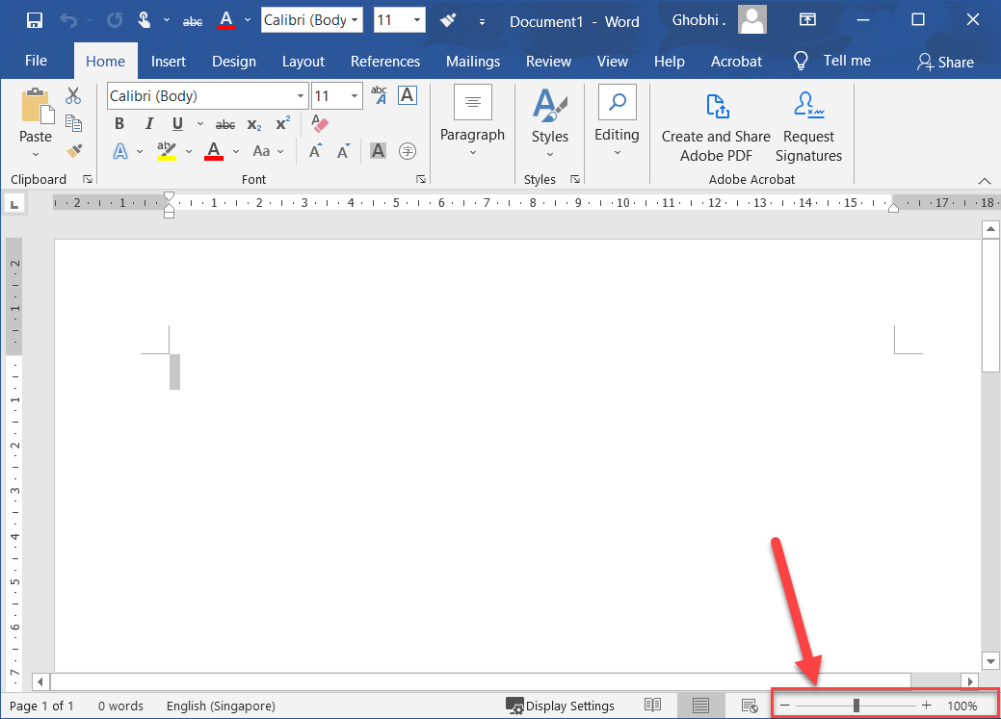
Understand the Screen
Zoom Slider: Use the zoom slider to change how big the document appears.
缩放滑块：使用缩放滑块更改文档显示的大小。

Slide 16
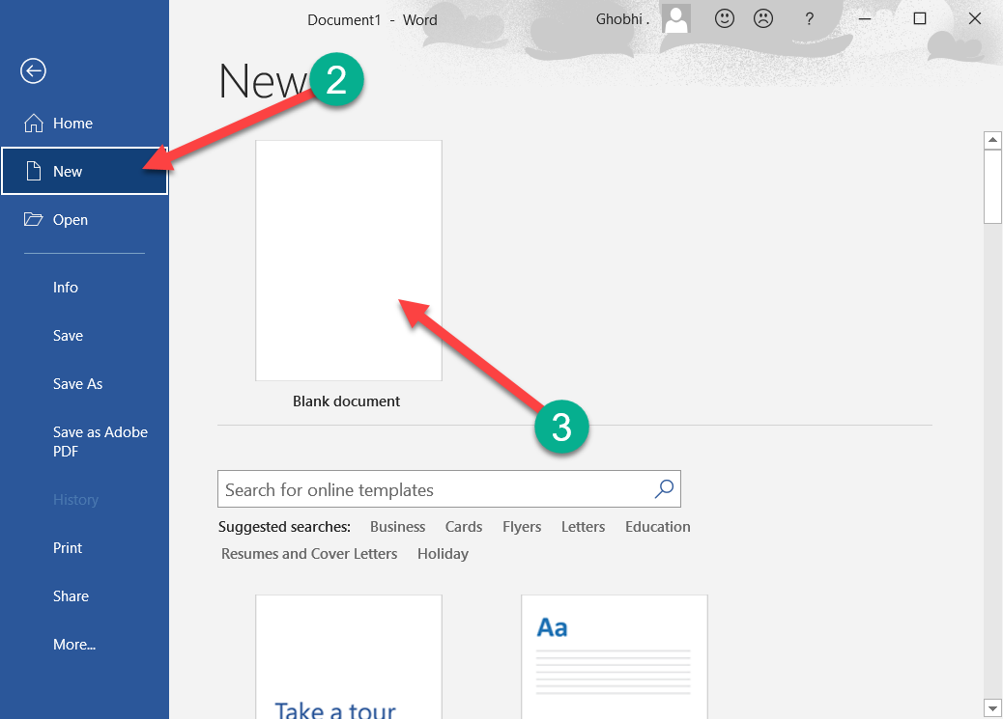
Create New Documents
Creating a new document is one of the most basic commands you need in Word.
创建新文档是 Word 中所需的最基本命令之一。
You can create a new blank document, or you can create a new document based on a template.
您可以创建一个新的空白文档，也可以基于模板创建一个新文档。

Slide 17
Create New Documents
Create a Blank Document. 创建空白文档
Click the File tab. | 单击文件选项卡。
Click New. | 单击新建。
Select Blank Document. | 选择空白文档。

Slide 18
Create New Documents
A new, blank document is created in a new window.
在新窗口中创建一个新的空白文档。
Shortcut: Press Ctrl + N to open a new blank document.
快捷方式：按 Ctrl + N 打开一个新的空白文档

Slide 19
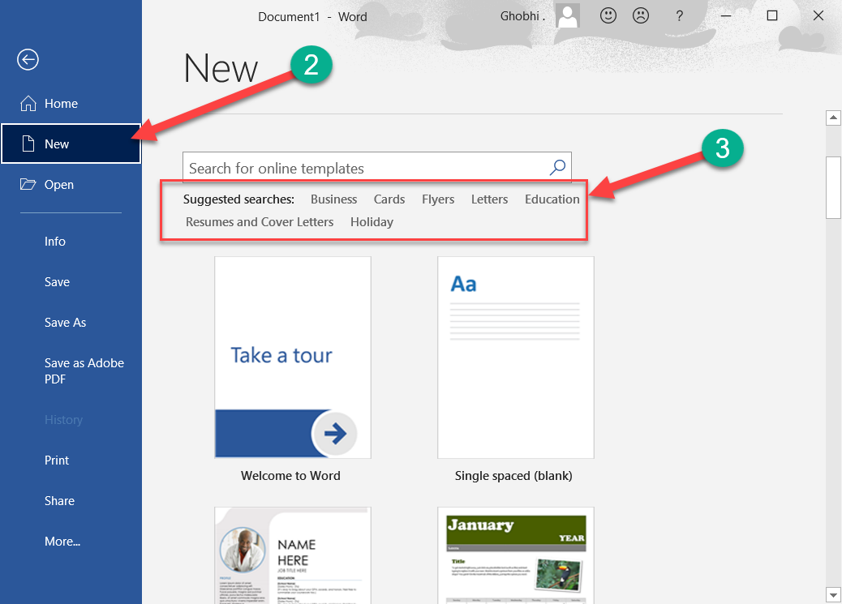
Create a Document from a Template
Click the File tab. | 单击文件选项卡。
Click New. | 单击新建。

Slide 20
Create a Document from a Template
The New screen has a few ways for you to select a template. First, several featured templates will appear, after the Blank document template.
“新建”屏幕提供了几种选择模板的方法。首先，在空白文档模板之后会出现几个特色模板。
You can also search for a template using the search field or select a template category from the suggested searches.
您还可以使用搜索字段搜索模板或从建议的搜索中选择模板类别。

Slide 21
Create a Document from a Template
Select or search for a template category. | 选择或搜索模板类别。
Preview images of the templates will appear for the selected category, along with a Category list.
将显示所选类别的模板预览图像以及类别列表。

Slide 22
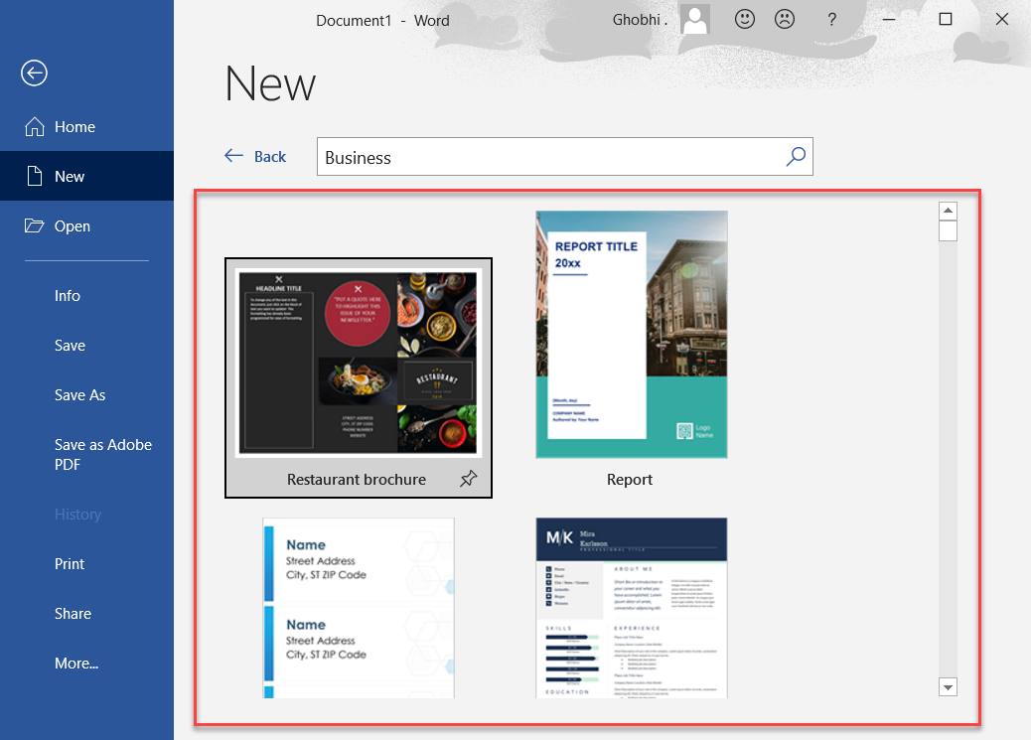
Create a Document from a Template
Select an additional category. | 选择其他类别。
Selecting additional categories allows you to narrow your template search even more.
选择其他类别可让您进一步缩小模板搜索范围。
Only templates that fit into all the selected categories will appear.
只有适合所有选定类别的模板才会出现。

Slide 23
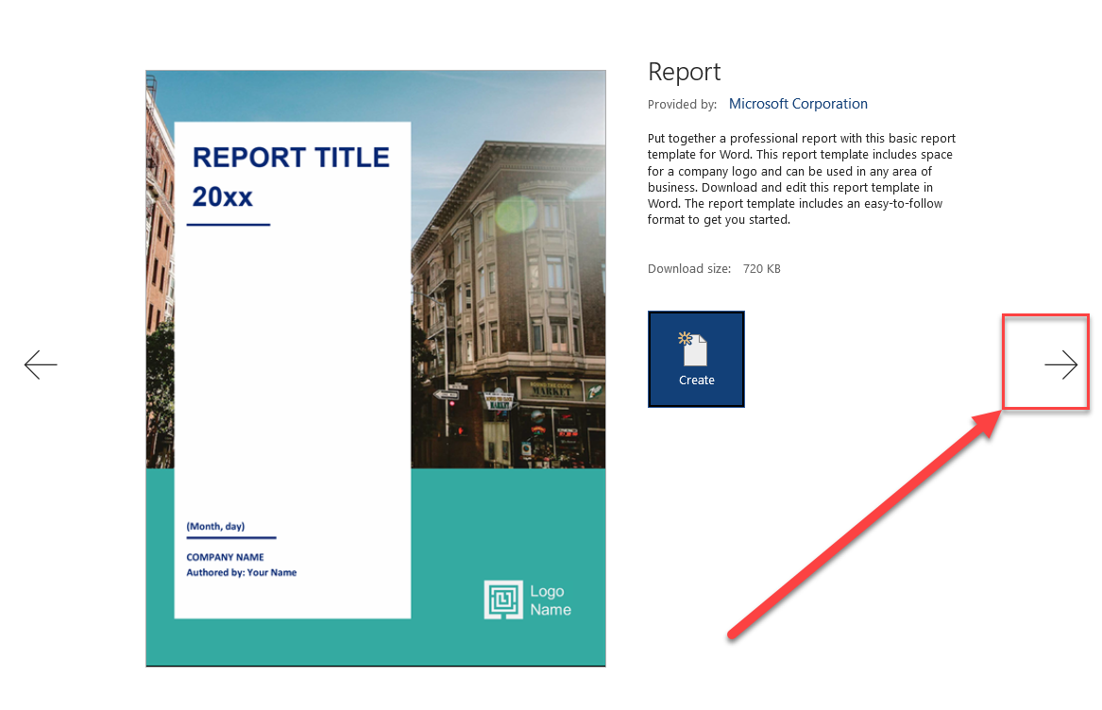
Create a Document from a Template
Select a template. | 选择一个模板。
A larger preview of the template appears, along with a description.
将出现模板的较大预览以及说明。

Slide 24
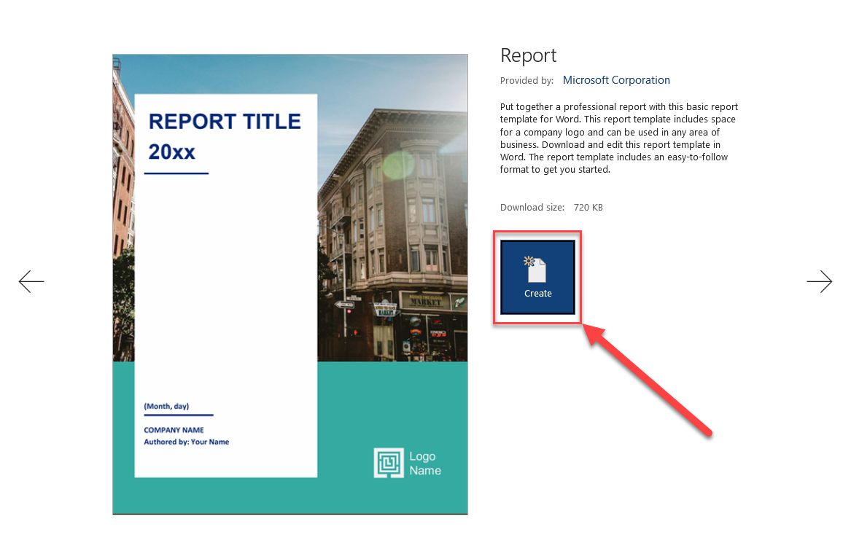
Create a Document from a Template
Click Create | 点击创建
A new document from the template is created. Now, just fill in the placeholders.
从模板创建一个新文档。现在，只需填写占位符。

Slide 25
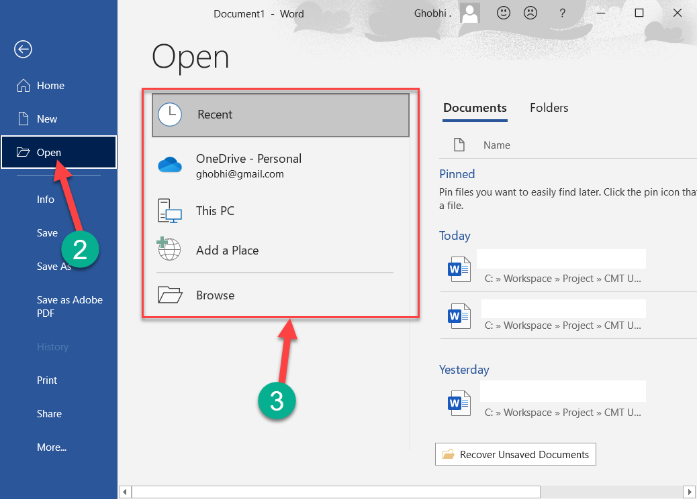
Open a File
Opening a file lets you resume working on a document that you have saved from earlier or that someone else has created and shared with you.
打开文件可让您继续处理之前保存的或其他人创建并与您共享的文档。
While you can open a document by double-clicking its icon in Windows, you can also browse and open files from within Word.
虽然您可以通过在 Windows 中双击其图标来打开文档，但您也可以在 Word 中浏览和打开文件。

Slide 26
Open a File
Click the File tab. | 单击文件选项卡。
Click Open. | 单击打开。
The Open screen appears, giving you a few ways to find a document.
出现打开屏幕，为您提供几种查找文档的方法。

Slide 27
Open a File
Select a location. | 选择一个位置。
Recent displays a list of documents that you’ve recently opened.
最近显示您最近打开的文档列表。
Your OneDrive and SharePoint sites will let you browse through the files stored on those cloud servers, if you have them.
您的 OneDrive 和 SharePoint 网站将允许您浏览存储在这些云服务器上的文件（如果有）。

Slide 28
Open a File
Select a location. | 选择一个位置。
This PC lets you browse through the Documents folder for files.
此 PC 可让您浏览 Documents 文件夹中的文件。
Clicking Browse opens a dialog box, where you can browse through your computer’s folders, drives, and network shares.
单击浏览会打开一个对话框，您可以在其中浏览计算机的文件夹、驱动器和网络共享。

Slide 29
Open a File
Select the file you want to open. | 选择要打开的文件
The selected file opens.
所选文件打开。
From the Browse dialog box, you’ll need to click the Open button after selecting the file.
在“浏览”对话框中，您需要在选择文件后单击“打开”按钮。

Slide 30
Open a PDF for Editing
In addition to opening Word’s regular file formats, you can also open PDF documents for editing.
除了打开 Words 常规文件格式，您还可以打开 PDF 文档进行编辑。

Slide 31
Open a PDF for Editing
Click the File tab. | 单击文件选项卡。
Click Open. | 单击打开。

Slide 32
Open a PDF for Editing
Select and open a PDF file. | 选择并打开一个 PDF 文件。
A dialog box appears, explaining that opening a PDF in Word converts it to a Word document and opens it as a copy. You’ll be able to edit the text, but some formatting and graphics may look different.
将出现一个对话框，说明在 Word 中打开 PDF 会将其转换为 Word 文档并将其作为副本打开。您将能够编辑文本，但某些格式和图形可能看起来不同。

Slide 33
Open a PDF for Editing
Click OK. | 单击确定。
A copy of the PDF is converted into an editable document, and it opens so that you can edit the text.
PDF 的副本将转换为可编辑的文档，并打开它以便您可以编辑文本。

Slide 34
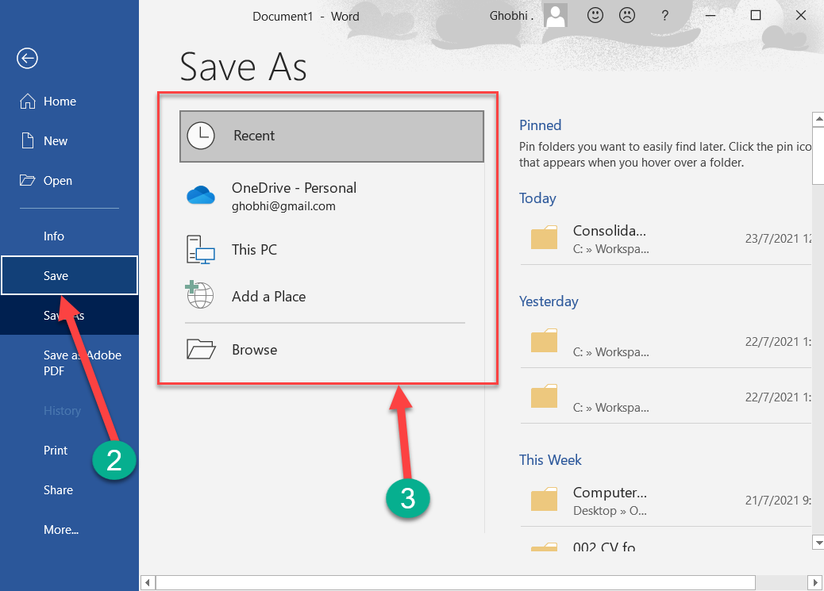
Save a File
After you’ve created a new document or made changes to an existing document, you’ll need to save it for those changes to be preserved.
创建新文档或对现有文档进行更改后，您需要保存它以保留这些更改。
You can also save a copy of an existing document, using a new name, a new location, or a different file type.
您还可以使用新名称、新位置或不同的文件类型来保存现有文档的副本。

Slide 35
Save a File
Click the Save button on the Quick Access Toolbar. | 单击快速访问工具栏上的保存按钮。
Since the document doesn’t have a name or location yet, the Save As screen will appear.
由于文档还没有名称或位置，因此将出现另存为屏幕。

Slide 36
Save a File
Choose a location to save the file to:
选择一个位置来保存文件：
OneDrive, a cloud storage folder accessible to all computers and mobile devices that you’ve connected to your Office 365 account.
OneDrive，一个云存储文件夹，可供您连接到 Office 365 帐户的所有计算机和移动设备访问。

Slide 37
Save a File
Choose a location to save the file to:
选择一个位置来保存文件：
Select This PC to save the file locally in your Documents folder.
选择此 PC 将文件本地保存在您的 Documents 文件夹中。
Click Browse to open a dialog box, where you can browse through your computer’s folders, drives, and network shares.
单击浏览打开一个对话框，您可以在其中浏览计算机的文件夹、驱动器和网络共享。

Slide 38
Save a File
Enter a file name. | 输入文件名。
Click Save | 点击保存
The file is saved and can be safely closed for you to reopen later.
文件已保存并可安全关闭，以便您稍后重新打开。
Shortcut: Press Ctrl + S to save.
快捷方式：按 Ctrl + S 保存。

Slide 39
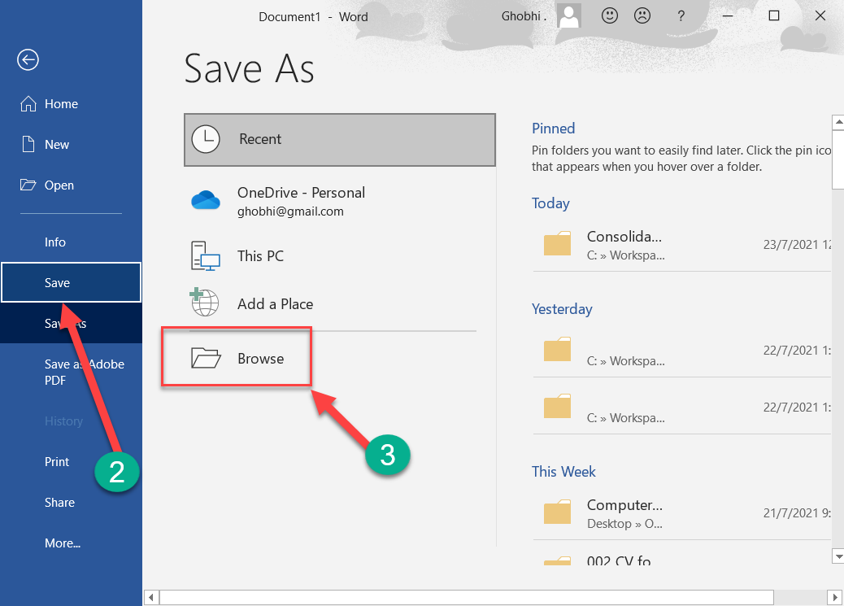
Save As a New File or Location
Sometimes you may want to make a copy of an existing document by saving it in a new location and/or with a new name.
有时您可能希望通过将现有文档保存在新位置和/或使用新名称来制作它的副本
Click the File tab. | 单击文件选项卡。
Click Save As. | 点击另存为

Slide 40
Save As a New File or Location
Select a location, by selecting either OneDrive, or This PC. Or, you can click Browse and navigate to the folder where you want to save your file. | 通过选择 OneDrive 或此电脑来选择一个位置。或者，您可以单击浏览并导航到要保存文件的文件夹。

Slide 41
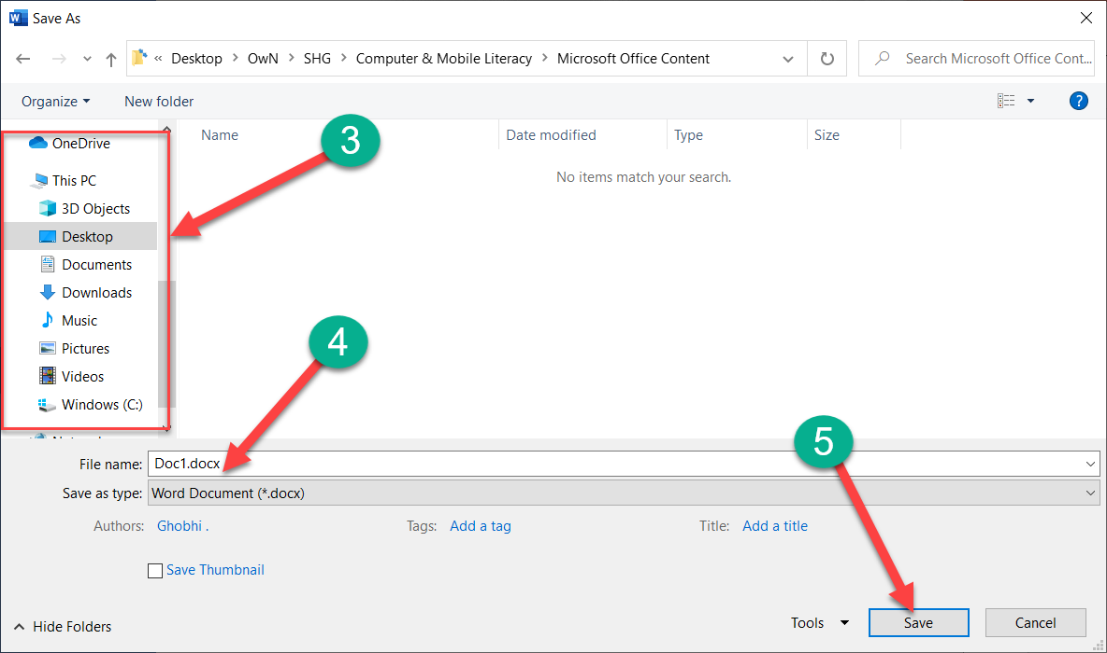
Save As a New File or Location
Enter a new file name. | 输入新文件名。
Click Save | 点击保存
The document is saved to the new location with the new name. The original file is automatically closed so you can start working in the new one right away.
文档将使用新名称保存到新位置。原始文件会自动关闭，因此您可以立即开始使用新文件.

Slide 42
Save to Different File Formats
Word normally saves its files as Word documents, but you can save your Word projects as other file formats too.
Word 通常将其文件保存为 Word 文档，但您也可以将 Word 项目保存为其他文件格式。
Click the File tab. | 单击文件选项卡。
Click Save As. | 单击另存为。
Choose where you want to save your file. | 选择要保存文件的位置。

Slide 43
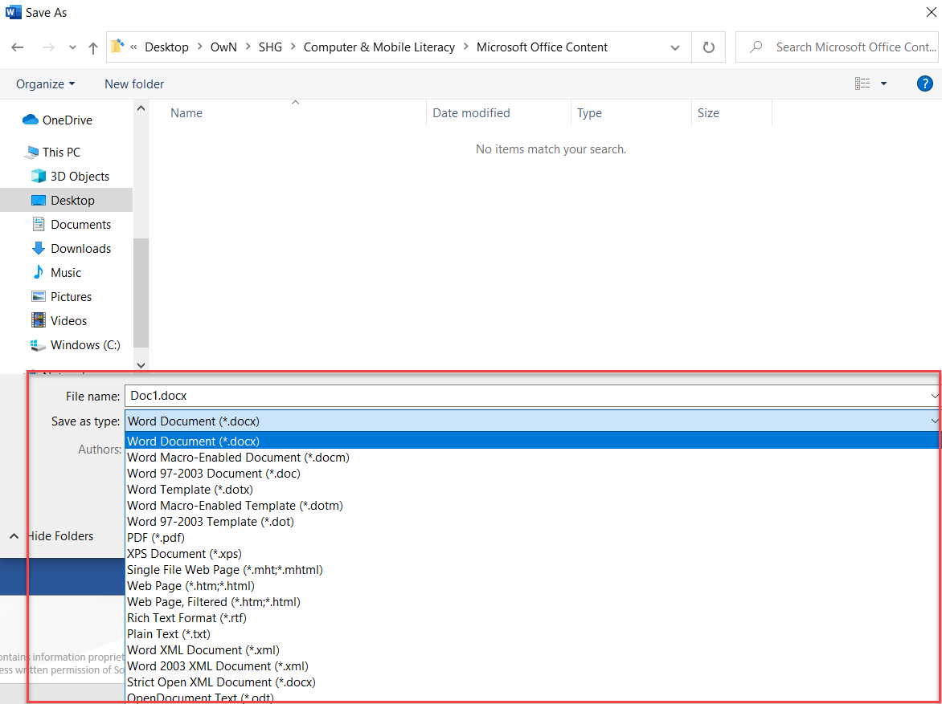
Save to Different File Formats
Click the Save as type list arrow. | 单击另存为类型列表箭头。
The drop-down list displays the different types of files you can save the document as. Select a file format. | 下拉列表显示您可以将文档另存为的不同类型的文件。选择文件格式。
Click Save. | 单击保存。
A copy of the file is saved in the new format.
文件的副本以新格式保存

Slide 44
Common Word File Formats
File Format | Explanation | 解释
Word Document (.docx) | This is the default format for Word documents | 这是 Word 文档的默认格式
Word Macro-Enabled Document (.docm) | This is a version of the default Word file type that supports macros, which allow for small tasks to be automated | 这是支持宏的默认 Word 文件类型的一个版本，允许自动执行小任务
Word 97-2003 Document (.doc) | Documents in this format can be read by all previous versions of Word, but lack some advanced features. They are also larger than .docx files and are more prone to corruption | 所有以前版本的 Word 都可以阅读这种格式的文档，但缺少一些高级功能。它们也比 .docx 文件大，更容易损坏

Slide 45
Common Word File Formats
File Format | Explanation | 解释
PDF (.pdf) | A PDF preserves a document as how it would appear when printed and can be shared electronically to be viewed on many kinds of devices. | PDF 将文档保留为打印时的显示方式，并且可以以电子方式共享以在多种设备上查看。
Web Page (.htm, .html) | This format creates pages that can be uploaded to the web and viewed in a browser | 这种格式创建的页面可以上传到网络并在浏览器中查看
Rich Text (.rtf | This basic format can be opened by nearly any text editor and preserves basic font formatting. | 这种基本格式几乎可以由任何文本编辑器打开，并保留基本字体格式。
Plain Text (.txt) | This simple file type saves only text with no formatting or page layout | 这种简单的文件类型只保存没有格式或页面布局的文本

Slide 46
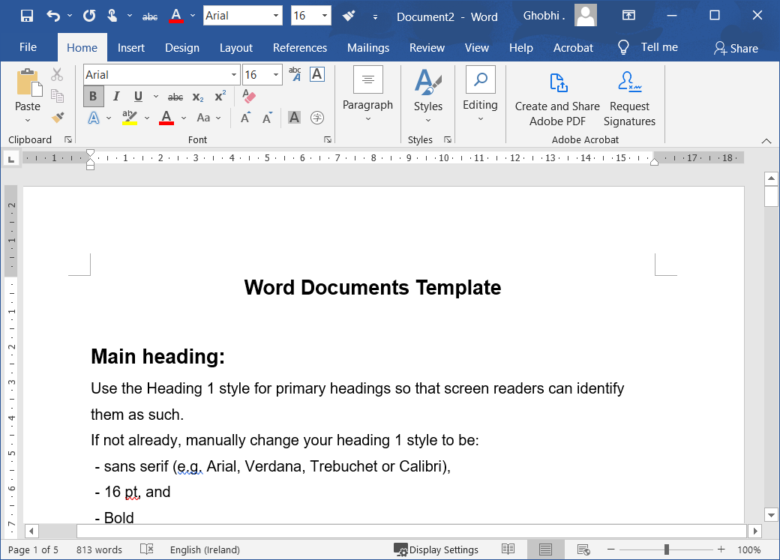
Navigate a Document
While working on a document, you'll often need to move the text cursor around to change where you're typing.
在处理文档时，您通常需要四处移动文本光标以更改打字位置.
Click anywhere inside the document.
单击文档内的任意位置.
The insertion point is the blinking vertical bar that represents where text will be inserted as you type.
插入点是闪烁的垂直条，表示在您键入时将插入文本的位置.

Slide 47
Navigate a Document
The insertion point moves to where you clicked—or, at least, as close as possible. If you click in a margin, or after the end of the text toward the bottom of the page, the insertion point moves to the closest point it can.
插入点移动到您单击的位置，或者至少尽可能靠近。如果您在页边空白处单击，或在靠近页面底部的文本结尾处单击，插入点将移动到它所能达到的最近点。

Slide 48
Navigate a Document
You can also move the insertion point around using the keyboard. This method is described in the table below.
您还可以使用键盘四处移动插入点。该方法在下表中描述。

Slide 49
Navigate a Document
You can also move the insertion point around using the keyboard. This method is described in the table below.
您还可以使用键盘四处移动插入点。该方法在下表中描述。

Slide 50
Navigate a Document
Press | To move the Insertion Point | 移动插入点
Arrows (↑↓←→) | Up or down one line; or left or right one character. | 向上或向下一行；或左或右一个字符。
Home | To the beginning of the current line. | 到当前行的开头。
End | To the end of the current line | 到当前行的末尾
Page Up | Up one screen, while also scrolling the page the same distance | 向上一屏，同时也将页面滚动相同的距离
Page Down | Down one screen, while also scrolling the page the same distance | 向下一屏，同时也将页面滚动相同的距离

Slide 51
Navigate a Document
Press | To move the Insertion Point
Ctrl + Arrows (↑↓←→) | Up or down one paragraph; or left or right one word. | 上下一段；或左或右一个字。
Ctrl + Home | To the beginning of the document | 到文档的开头
Ctrl + End | To the end of the document | 到文件末尾

Slide 52
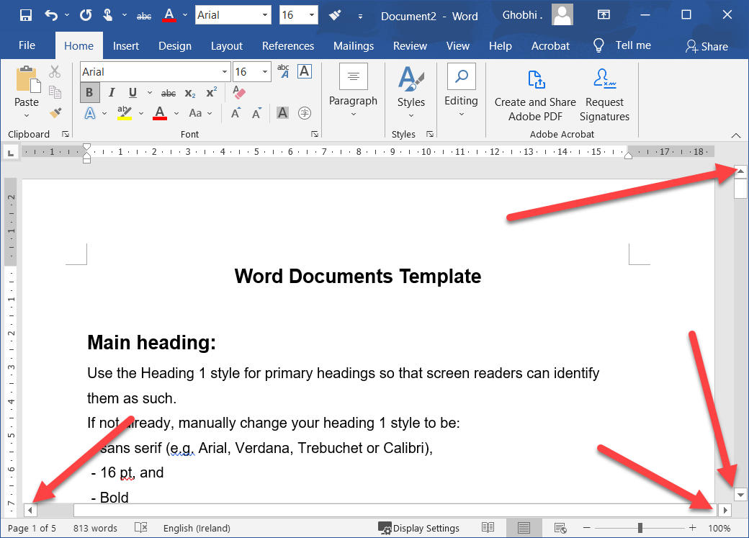
Scroll in a Document
When a document gets long enough, it can be tough to navigate through the whole thing with just the keyboard. You can use the scroll bars on the right and bottom sides of the window to move through the document quickly.
当文档变得足够长时，仅靠键盘就很难浏览整个文档。您可以使用窗口右侧和底部的滚动条快速浏览文档。

Slide 53
Scroll in a Document
Click the arrow buttons at the top, bottom, and sides of the scroll bar to scroll one line at a time.
单击滚动条顶部、底部和侧面的箭头按钮，一次滚动一行。
Click and drag a scroll bar to move quickly though a document, releasing it when you’ve reached the page you want.
单击并拖动滚动条可在文档中快速移动，到达所需页面时松开滚动条。

Slide 54
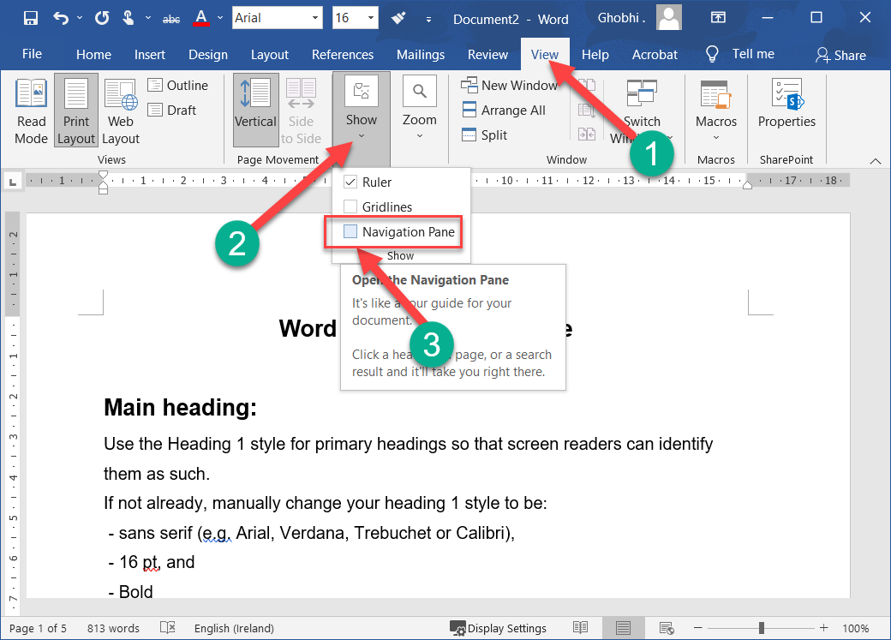
Use the Navigation Pane
If you have a longer document with multiple pages, or you’ve set up your document into sections with headings, you can use the Navigation Pane to move quickly through sections and pages.
如果您有包含多个页面的较长文档，或者您已将文档设置为带有标题的部分，您可以使用导航窗格快速浏览部分和页面

Slide 55
Use the Navigation Pane
Click the View tab on the ribbon. | 单击功能区上的“视图”选项卡
Select the Navigation Pane check box in the Show group. | 选中“显示”组中的“导航窗格”复选框。
The Navigation Pane appears on the left side of the screen, showing headings used in the document. Clicking one will jump to that heading.
导航窗格出现在屏幕左侧，显示文档中使用的标题。单击一个将跳转到该标题。

Slide 56
Use the Navigation Pane
Click Pages. | 单击页面。
The Navigation Pane now shows every page in the document, represented by a thumbnail.
导航窗格现在显示文档中的每一页，由缩略图表示。
Click a page in the Navigation Pane. | 单击导航窗格中的页面。
Word navigates right to the selected page.
Word 向右导航到所选页面

Slide 57
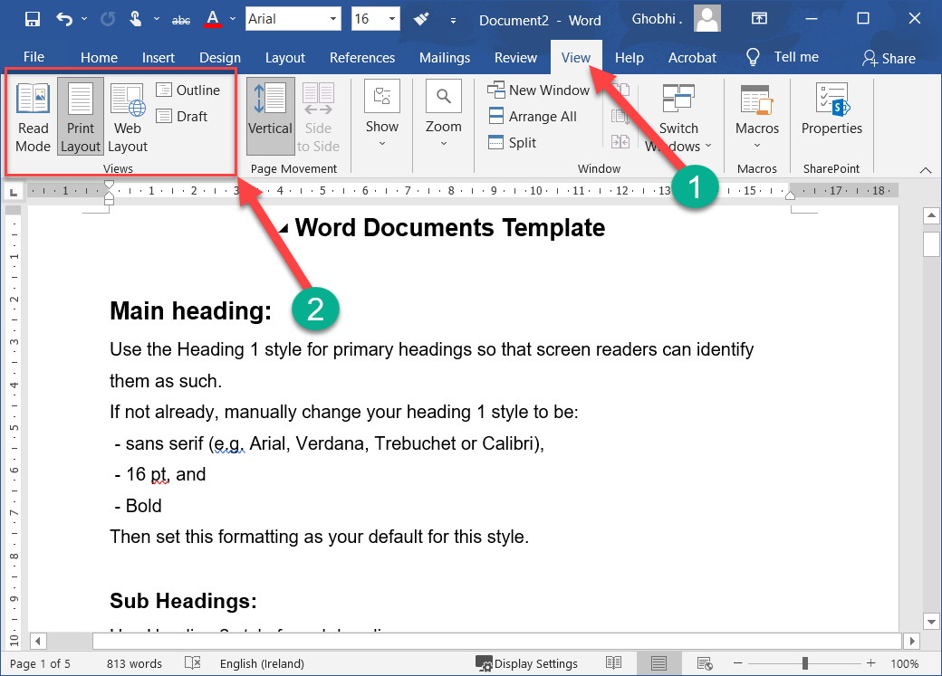
View Documents
There are several ways to change how a document’s contents are displayed on the screen using the preset document views.
有多种方法可以使用预设的文档视图更改文档内容在屏幕上的显示方式。
You can also zoom in or out to view more or less of the page at a time and view multiple documents at once.
您还可以放大或缩小一次查看更多或更少的页面并一次查看多个文档

Slide 58
View Documents
Click the View tab. | 单击视图选项卡。
Select a view. | 选择一个视图。
Read Mode only shows necessary toolbars, making room for enlarged text and navigational tools.
阅读模式只显示必要的工具栏，为放大的文本和导航工具腾出空间。
This view is read-only, so you won’t be able to make edits.
此视图是只读的，因此您将无法进行编辑。

Slide 59
View Documents
Click the View tab. | 单击视图选项卡。
Select a view. | 选择一个视图。
Print Layout view displays your document as it will appear when printed.
打印版面视图显示您的文档，就像打印时一样。
It’s best for working in documents with advanced formatting.
最适合处理具有高级格式的文档。

Slide 60
View Documents
Click the View tab. | 单击视图选项卡。
Select a view. | 选择一个视图。
Web Layout view shows backgrounds, wraps text to fit inside the window, and positions graphics just as they are in a web browser.
Web 布局视图显示背景，将文本换行以适应窗口，并像在 Web 浏览器中一样定位图形。

Slide 61
View Documents
Click the View tab. | 单击视图选项卡。
Select a view. | 选择一个视图。
Outline view displays your document in classic outline form.
大纲视图以经典大纲形式显示您的文档。

Slide 62
View Documents
Click the View tab. | 单击视图选项卡。
Select a view. | 选择一个视图。
Draft view works well for most simple word-processing tasks, such as typing, editing, and simple formatting.
草稿视图适用于大多数简单的文字处理任务，例如打字、编辑和简单的格式设置。

Slide 63
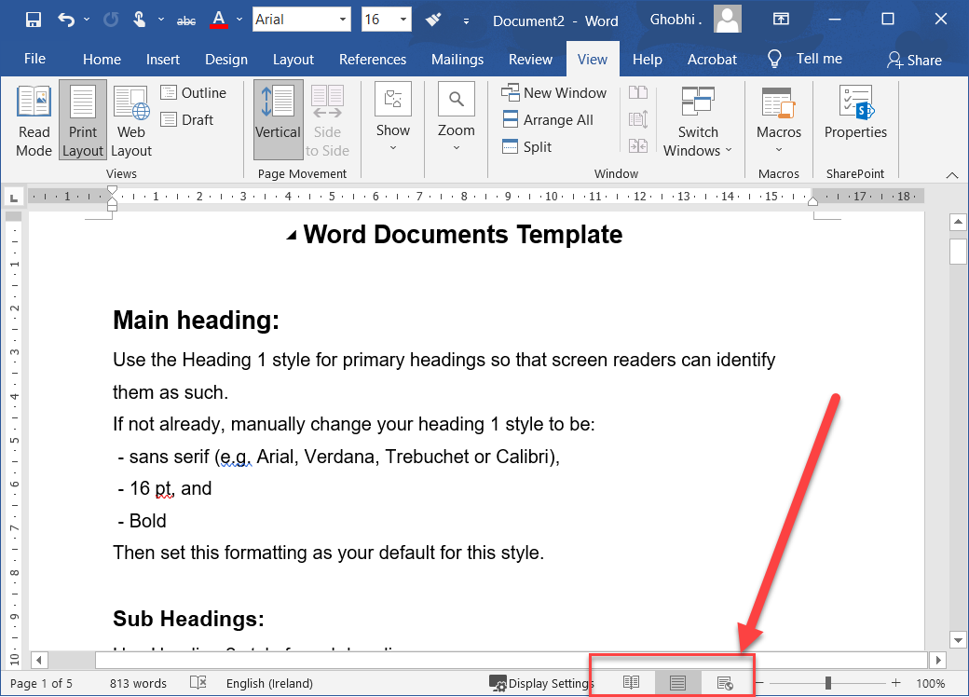
View Documents
Does not display advanced formatting, such as page boundaries, headers and footers, or floating pictures.
不显示高级格式，例如页面边界、页眉和页脚或浮动图片。
You can also quickly access Read Mode, Print Layout, and Web Layout views from the View buttons in the status bar.
您还可以从状态栏中的“查看”按钮快速访问阅读模式、打印布局和 Web 布局视图。

Slide 64
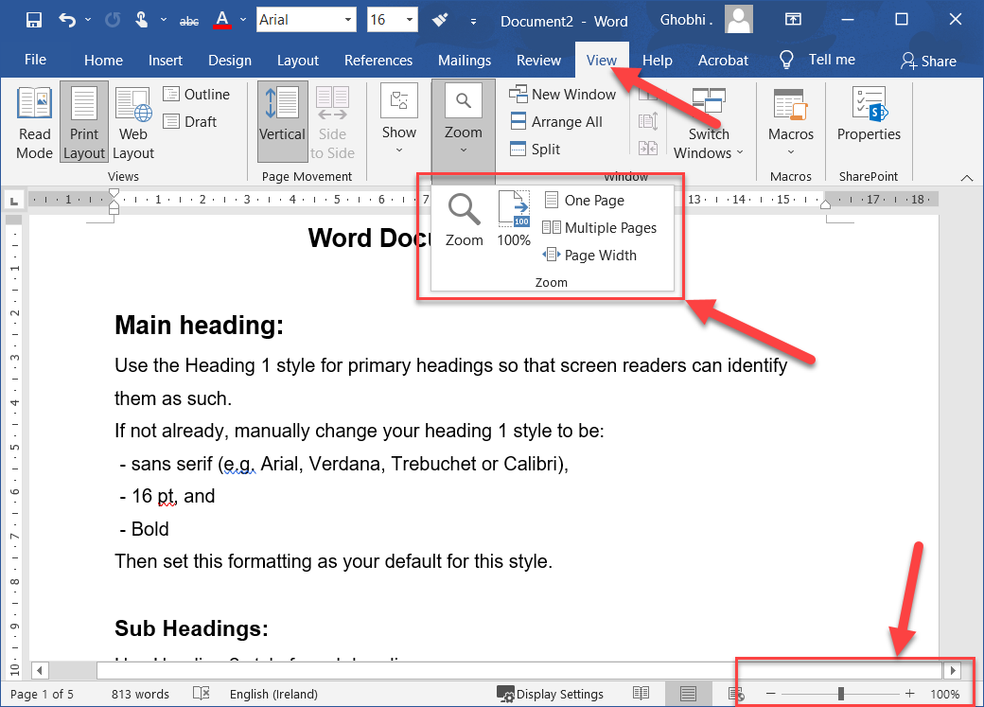
Zoom
Sometimes it is helpful to make a document appear larger on the computer’s screen, especially if you have a small monitor or poor eyesight.
有时，使文档在计算机屏幕上显得更大是有帮助的，尤其是当您的显示器较小或视力不佳时。
It can also be helpful to zoom out so that you can see how the whole document looks.
缩小也很有帮助，以便您可以看到整个文档的外观

Slide 65
Zoom
Click the Zoom In or Zoom Out buttons on the status bar. The page zooms in or out. | 单击状态栏上的放大或缩小按钮。页面放大或缩小。
Click and drag the zoom slider to adjust the zoom level. Using the zoom slider is a more precise way to adjust the zoom on your document. |单击并拖动缩放滑块以调整缩放级别。使用缩放滑块可以更精确地调整文档的缩放比例。

Slide 66
Zoom
Click one of the options in the Zoom group on the View tab of the ribbon to control the zoom level further. | 单击功能区“视图”选项卡上“缩放”组中的选项之一以进一步控制缩放级别。
Click the Zoom button to open the Zoom dialog box, where you can specify a zoom level.
单击缩放按钮打开缩放对话框，您可以在其中指定缩放级别。

Slide 67
Zoom
Click one of the options in the Zoom group on the View tab of the ribbon to control the zoom level further. | 单击功能区“视图”选项卡上“缩放”组中的选项之一以进一步控制缩放级别。
Click the 100% button on the View tab to return your document to viewing at 100%.
单击“查看”选项卡上的 100% 按钮可将文档返回到 100% 查看。

Slide 68
Zoom
Click one of the options in the Zoom group on the View tab of the ribbon to control the zoom level further. | 单击功能区“视图”选项卡上“缩放”组中的选项之一以进一步控制缩放级别。
Click the One Page button to zoom the document out so that one entire page is visible in the window.
单击一页按钮缩小文档，以便在窗口中可以看到整个页面

Slide 69
Zoom
Click one of the options in the Zoom group on the View tab of the ribbon to control the zoom level further. |单击功能区“视图”选项卡上“缩放”组中的选项之一以进一步控制缩放级别。
Click the Page Width button to automatically zoom the document in so that the page fills the window side-to-side.
单击页面宽度按钮可自动放大文档，以便页面并排填充窗口。

Slide 70
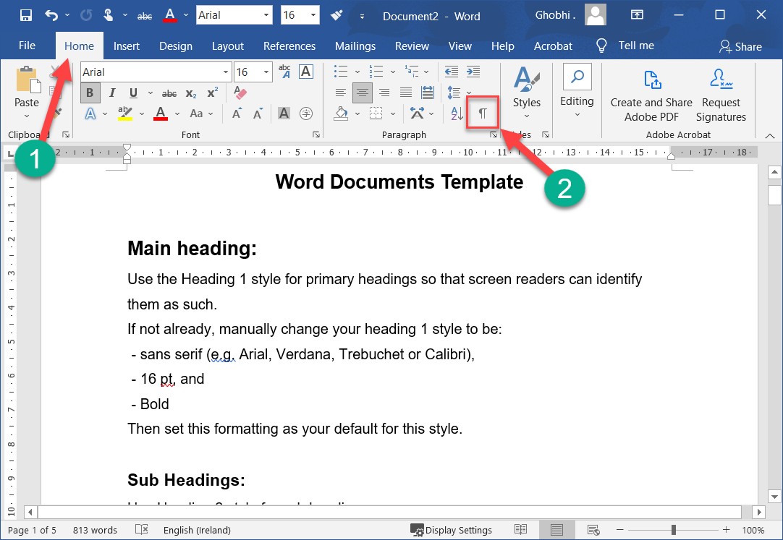
Show or Hide Formatting Symbols
Every document is filled with hidden formatting symbols that help control how the text is laid out on the page. New paragraphs, carriage returns, tabs, spaces, and page breaks can be seen, selected, moved, and deleted.
每个文档都充满了隐藏的格式符号，有助于控制文本在页面上的布局。可以查看、选择、移动和删除新段落、回车、制表符、空格和分页符。

Slide 71
Show or Hide Formatting Symbols
Viewing these formatting symbols lets you see where you may have added extra spaces between words, for example, or whether spaces or tab stops were used to indent text.
通过查看这些格式符号，您可以了解可能在单词之间添加额外空格的位置，或者是否使用空格或制表位来缩进文本。

Slide 72
Show or Hide Formatting Symbols
Click the Home tab. | 单击主页选项卡。
Click the Show/Hide ¶ icon. | 单击显示/隐藏 ¶ 图标。
The hidden formatting symbols are now shown. These symbols represent spaces, new paragraphs, page breaks, and other bits of text and page formatting
现在显示隐藏的格式符号。这些符号代表空格、新段落、分页符以及其他文本和页面格式

Slide 73
Show or Hide Formatting Symbols
Click the Show/Hide ¶ button again. | 再次单击显示/隐藏 ¶ 按钮
The symbols are hidden once again.
符号再次隐藏。
Shortcut: Press Ctrl + * to display or hide the formatting symbols
快捷方式：按 Ctrl + * 显示或隐藏格式符号

Slide 74
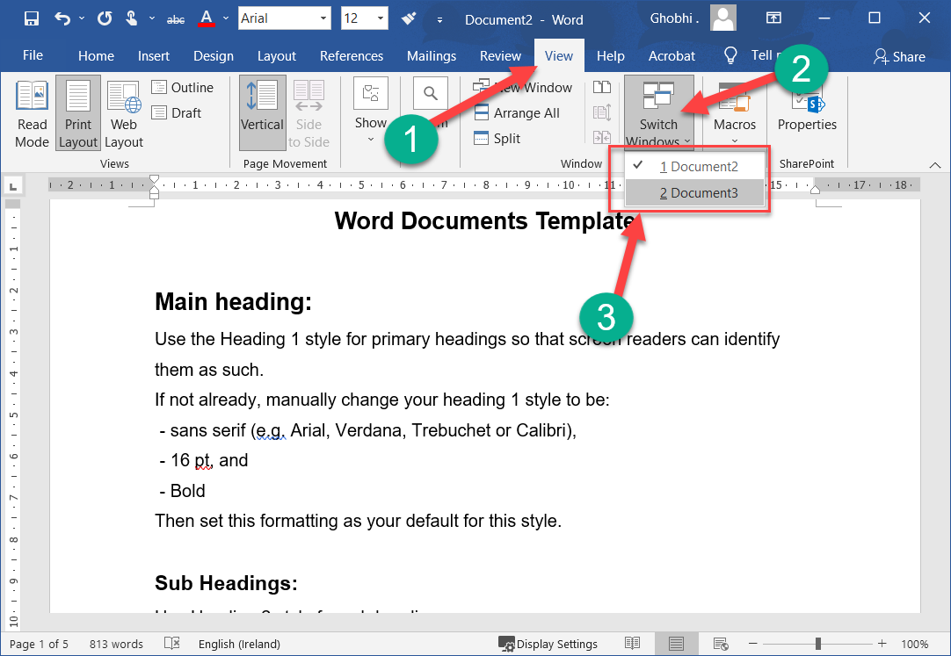
View Multiple Documents
If you have several documents open in Word, you can switch between them while they are all open.
如果您在 Word 中打开了多个文档，您可以在它们都打开时在它们之间切换。

Slide 75
View Multiple Documents
Click the View tab on the ribbon. | 单击功能区上的“视图”选项卡
Click the Switch Windows button. | 单击切换 Windows 按钮
All the documents currently open are listed, with a check next to the active one.
当前打开的所有文档都被列出，活动文档旁边有一个勾号。

Slide 76
View Multiple Documents
Select another document. | 选择另一个文档。
The other document comes to the front.
另一个文件出现在前面

Slide 77
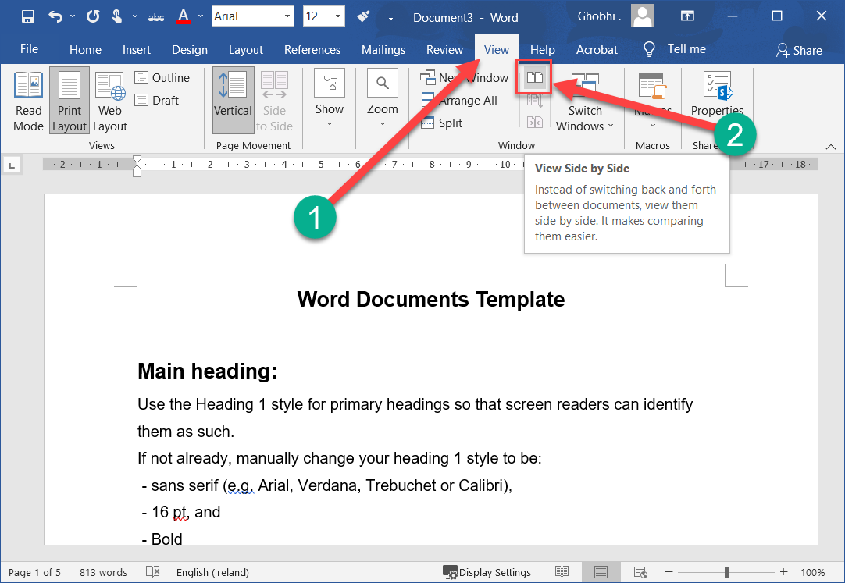
View Documents Side by Side
If you need to compare the contents of two documents to each other, you can also view them side by side.
如果您需要将两个文档的内容相互比较，您也可以并排查看它们。

Slide 78
View Documents Side by Side
With two documents open at the same time, click the View Side by Side button. | 同时打开两个文档，单击“并排查看”按钮。
The windows are resized so that they'll both fit on the screen, and they're arranged side by side.
窗口被调整大小，以便它们都适合屏幕，并且它们并排排列。

Slide 79
View Documents Side by Side
While viewing documents side by side, the Synchronous Scrolling feature is enabled.
并排查看文档时，同步滚动功能已启用。
When you scroll one document up or down, the other document will scroll at the same speed.
当您向上或向下滚动一个文档时，另一个文档将以相同的速度滚动。
You can turn this feature off by clicking the Synchronous Scrolling button.
您可以通过单击同步滚动按钮关闭此功能。

Slide 80
View Documents Side by Side
Click the View Side by Side button again. | 再次单击“并排查看”按钮。
The windows return to normal.
窗户恢复正常。

Slide 81
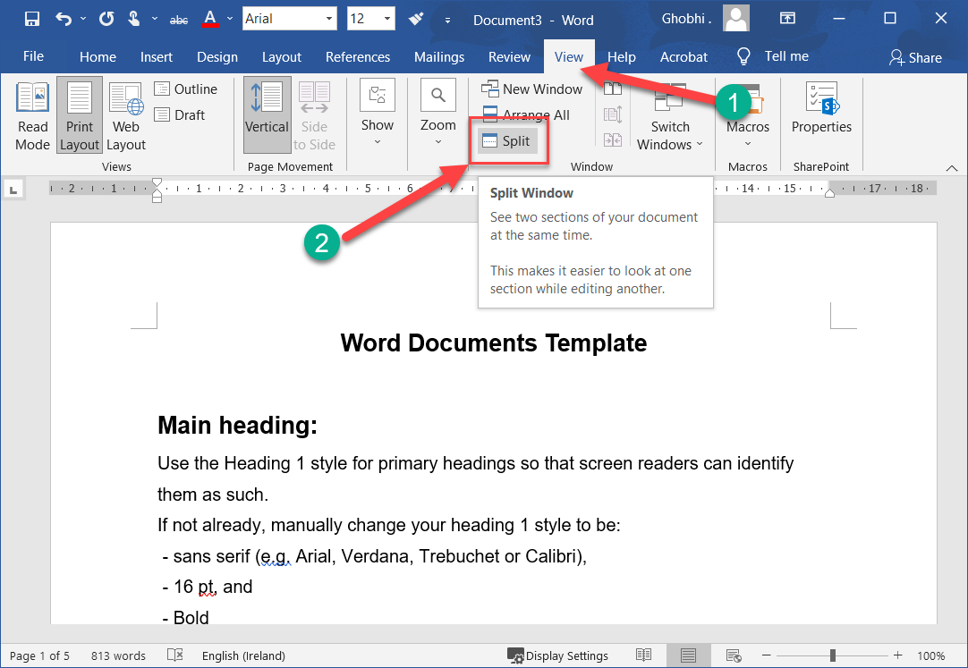
Split the Window
You can also split a Word document window in two, with two panes each showing part of the same document.
您还可以将 Word 文档窗口一分为二，两个窗格分别显示同一文档的一部分。

Slide 82
Split the Window
Click the Split Window button on the View tab. | 单击“视图”选项卡上的“拆分窗口”按钮。
The window is split into two panes, one on top and one on the bottom. Both panes show the current document but can be scrolled independently. This lets you keep an eye on one part of the document while typing and editing another. 窗口分为两个窗格，一个在顶部，一个在底部。两个窗格都显示当前文档，但可以独立滚动。这使您可以在键入和编辑另一部分时留意文档的一个部分。

Slide 83
Split the Window
Click the Split Window button on the View tab. | 单击“视图”选项卡上的“拆分窗口”按钮。
Click and drag the border between the panes to adjust the size of the panes.
单击并拖动窗格之间的边框以调整窗格的大小。

Slide 84
Split the Window
Click the Remove Split button. | 单击删除拆分按钮。
The split is removed, and you’re back to viewing the document in a single pane.
拆分已删除，您将返回到在单个窗格中查看文档。

Slide 85
Split the Window
Clicking the New Window button on the View tab does something similar, opening a second window of the current document.
单击“视图”选项卡上的“新建窗口”按钮执行类似操作，打开当前文档的第二个窗口。
This lets you arrange the two windows however you want, viewing two different parts of the document at once.
这使您可以随意排列两个窗口，同时查看文档的两个不同部分

Slide 86
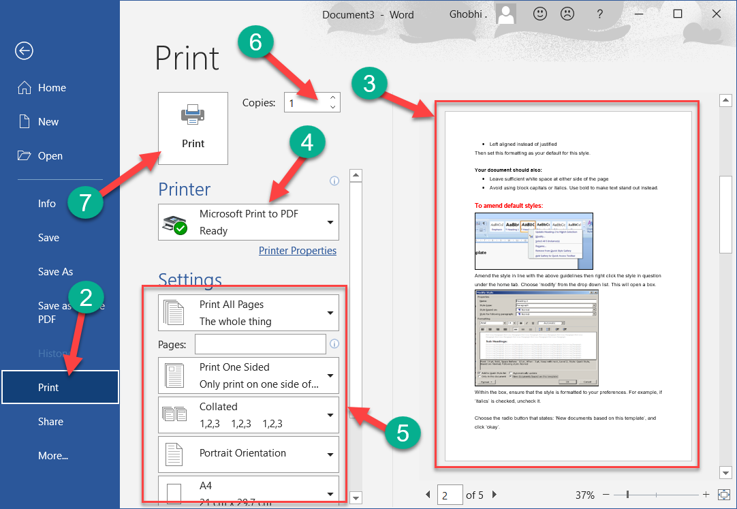
Print
When you’re ready to print a document, and if you have a printer connected to your computer, you can preview a document and print it.
当您准备好打印文档时，如果您的计算机连接了打印机，您可以预览文档并打印它

Slide 87
Print
Click the File tab. | 单击文件选项卡。
Click Print. | 单击打印。
Examine the print preview on the right side of the screen to ensure the document appears correct. | 检查屏幕右侧的打印预览以确保文档显示正确。

Slide 88
Print
Select the correct printer by clicking the Printer list arrow and selecting it from the list. | 单击打印机列表箭头并从列表中选择正确的打印机。
Adjust the printer settings using the options below the printer, described in the following table. | 使用打印机下方的选项调整打印机设置，如下表所述。

Slide 89
Print
Set the number of copies in the Copies text field. | 在份数文本字段中设置份数。
Click Print. | 点击打印
The document is sent to the printer.
Shortcut: Press Ctrl + P
文档被发送到打印机。
快捷键：按Ctrl + P

Slide 90
Print
Print Settings | Explanation
Print Range | Print the whole document, a certain page range, a single section, or just even or odd pages. | 打印整个文档、特定页面范围、单个部分或仅打印偶数页或奇数页。
Print One Sided / Both Sides | Print the document one-sided, enable a printer’s two-sided printing function, or manually flip the pages during printing | 单面打印文档，启​​用打印机的双面打印功能，或在打印过程中手动翻页
Collate | Collating prints multiple copies of the document all the way through (1, 2, 3, 1, 2, 3), while printing uncollated prints multiple copies of each page together (1, 1, 2, 2, 3, 3). | 分页打印文档的多份副本 (1, 2, 3, 1, 2, 3)，而打印未分页的打印每页的多份副本 (1, 1, 2, 2, 3, 3)。

Slide 91
Print
Print Settings | Explanation
Orientation | Select Portrait (taller) or Landscape (wider) | 选择纵向（较高）或横向（较宽）
Page Size | Select the size of paper you’re printing on | 选择要打印的纸张尺寸
Page Margins | Adjust the margins between the edge of the page and the text | 调整页面边缘和文本之间的边距
Pages Per Sheet | Arrange multiple pages on a single sheet. | 在一张纸上排列多个页面。

Slide 92
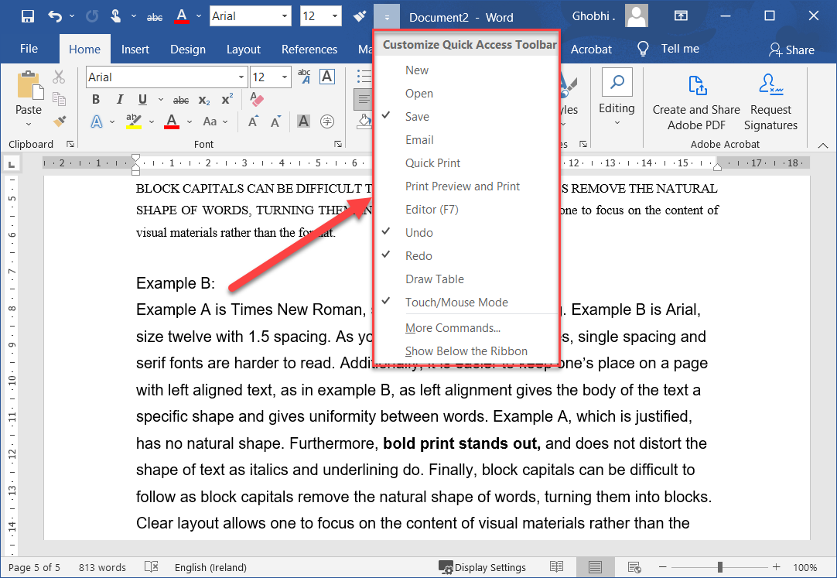
Quick Access Toolbar
The Quick Access Toolbar holds a few buttons for commands that you'll use often, such as save, undo, redo, and repeat. They’ll always be available, no matter which ribbon tab you’re on.
快速访问工具栏包含一些用于您经常使用的命令的按钮，例如保存、撤消、重做和重复。无论您使用哪个功能区选项卡，它们始终可用

Slide 93
Quick Access Toolbar
If the Quick Access Toolbar doesn’t contain enough of your frequently used commands, you can customize it by adding or deleting commands.
如果快速访问工具栏没有包含足够多的常用命令，您可以通过添加或删除命令来自定义它。
Click the Customize Quick Access Toolbar button. | 单击自定义快速访问工具栏按钮。
A list appears and displays some commands you can add. 将出现一个列表并显示一些您可以添加的命令。

Slide 94
Quick Access Toolbar
Select the command you want to add. | 选择要添加的命令。
The button is added to the toolbar.
按钮被添加到工具栏。

Slide 95
Quick Access Toolbar
You can find all the available commands you can add by selecting More Commands, which opens the Word Options dialog box.
您可以通过选择更多命令来找到可以添加的所有可用命令，这会打开 Word 选项对话框。
To remove a command, select a command with a checkmark to deselect it.
要删除命令，请选择带有复选标记的命令以取消选择它。

Slide 96
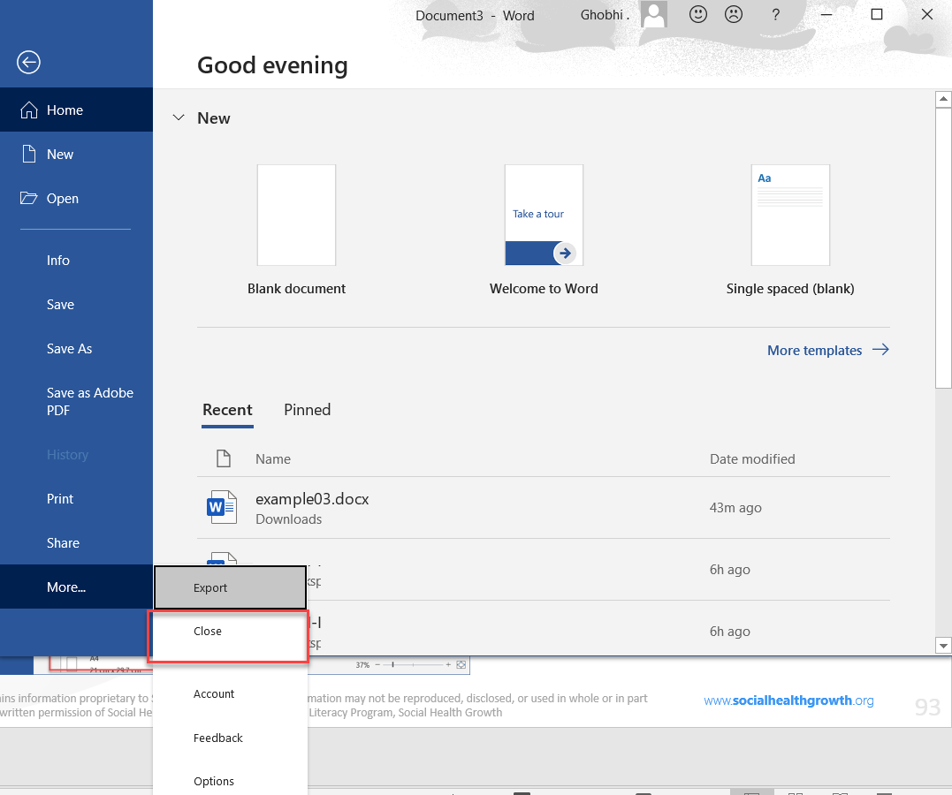
Close & Exit
When you're done working with a file, it's a good idea to close it so you don't bog down your computer with unused programs.
处理完文件后，最好将其关闭，以免因未使用的程序而使计算机陷入困境。

Slide 97
Close & Exit
Each document window must be closed individually. If you only have one file open, you can close it from the File menu and keep Word running.
每个文档窗口必须单独关闭。如果您只打开了一个文件，您可以从“文件”菜单中关闭它并保持 Word 运行。
Click the File tab. | 单击文件选项卡。
Click Close. | 单击关闭。

Slide 98
Close & Exit
The file is closed, but Word is still running.
该文件已关闭，但 Word 仍在运行。
You can still browse for a file to open, create a new document from a template, and access Word’s options.
您仍然可以浏览要打开的文件、从模板创建新文档以及访问 Word 的选项。

Slide 99
Close & Exit
If you have multiple Word documents open, clicking the Close button on the title bar will close each document individually.
如果您打开了多个 Word 文档，单击标题栏上的关闭按钮将分别关闭每个文档。

Slide 100
Close & Exit
If you have not saved the document since making changes, a dialog box will appear asking if you want to save the changes to the document.
如果您在进行更改后尚未保存文档，则会出现一个对话框，询问您是否要保存对文档的更改。

Slide 101
Close & Exit
Click Save if you wish to save your changes, click Don’t Save if you do not want to save your changes, and click Cancel if you do not want to close the document.
如果您希望保存更改，请单击“保存”，如果您不想保存更改，请单击“不保存”，如果您不想关闭文档，请单击“取消”。

Slide 102
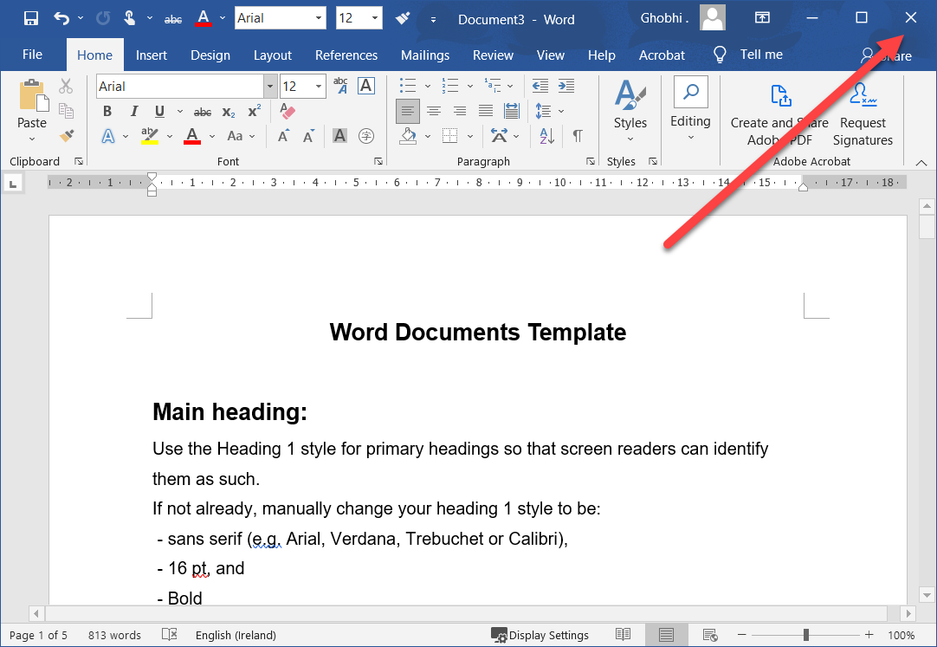
Close & Exit
If you only have one Word document open, closing the document window will also quit Word entirely.
如果您只打开了一个 Word 文档，关闭文档窗口也会完全退出 Word。
Click the Close button.
单击关闭按钮。
Word quits as the window closes.
Word 在窗口关闭时退出

Slide 103
Thank You!
Social Health Growth
200 Jalan Sultan #03-17, Textile Centre, Singapore 199018
Hotline: (65) 9751 6906, Fax: (65) 6338 2892
SHG is a registered Charity with Ministry of Social and Family Development
Website: www.socialhealthgrowth.org
Facebook: facebook.com/socialhealthgrowth.shg
Twitter: @SHG_Singapore
Instagram: socialhealthgrowth

